Slide 1
WaterSMART
Cooperative Watershed Management Program
Funding Opportunity Webinar
July 21, 2026

Slide 2

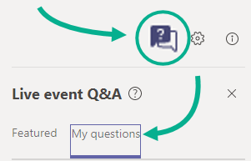
Getting Started
To watch the recording, use the same link: Join Live Teams Event
Attendees' cameras and microphones are muted
A copy of the slides will be available on our website after the webinar:
https://www.usbr.gov/watersmart/
Questions and comments can be posted in the Q&A icon on the bottom of the menu bar

Slide 3
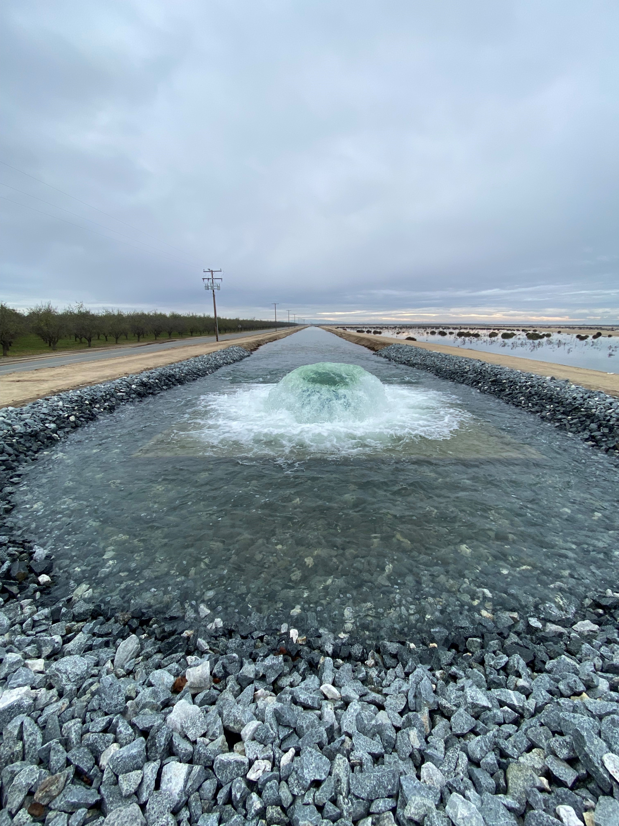

Agenda
Staff Introductions & Housekeeping Items
Quick WaterSMART Overview
Program Overview
Funding Opportunity Overview
Application Content
Merit Review Criteria
Environmental & Cultural Compliance Guidance
Financial Assistance Requirements
WaterSMART Application Tips
Additional Opportunities, Tools and Resources
Question & Answer Session

Slide 4
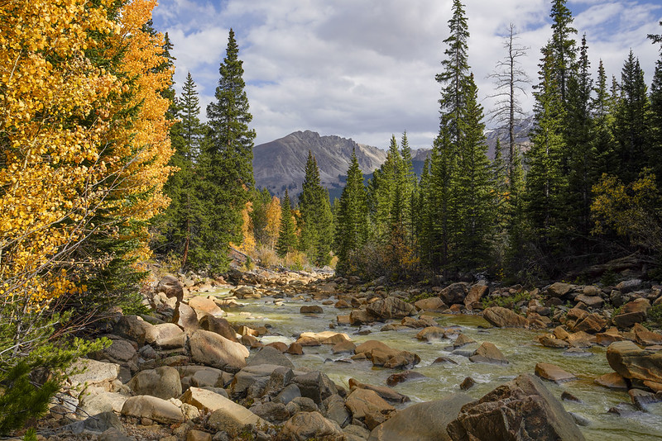
WaterSMART Overview

Slide 5
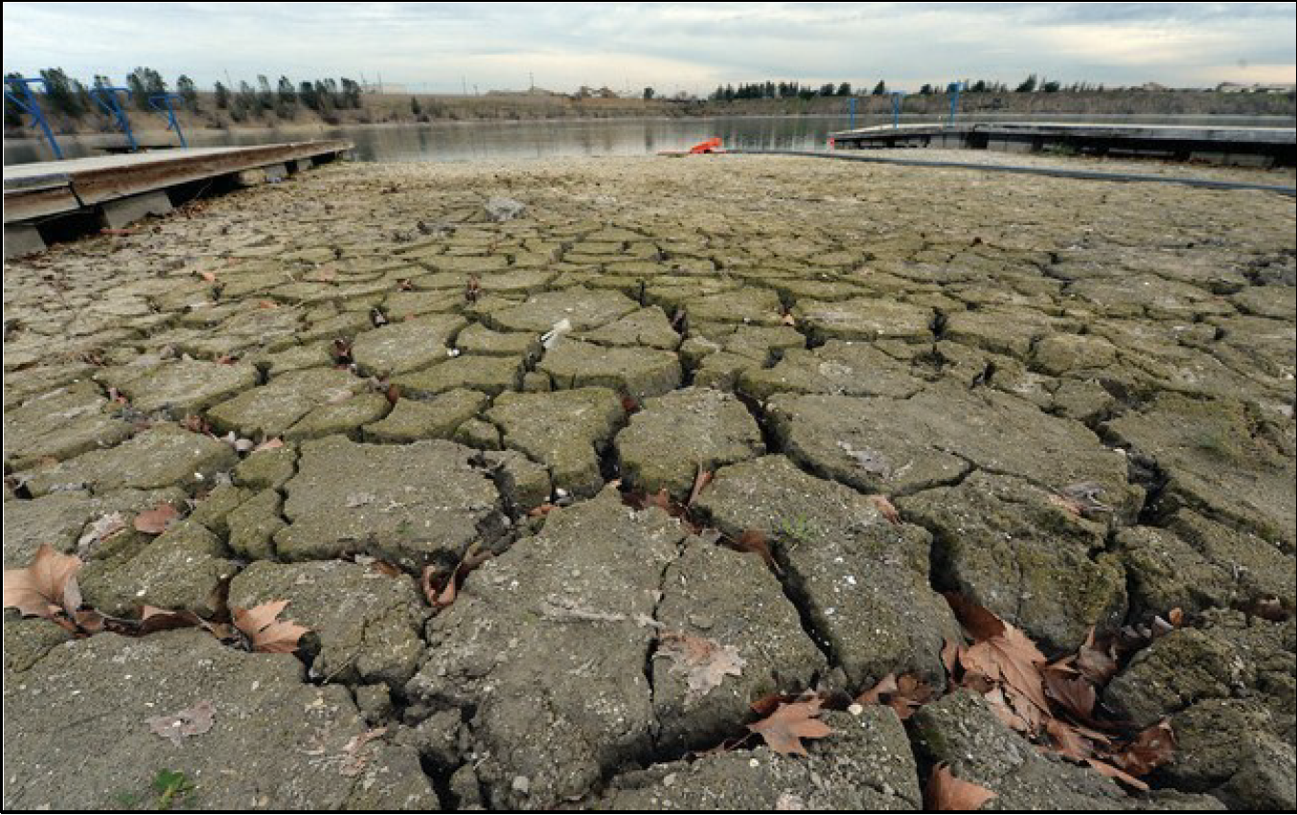
WaterSMART Program Overview
Increase Reliability
Competing Demands
Drought
The WaterSMART Program is an umbrella program composed of multiple Federal assistance opportunities.
Through WaterSMART, Reclamation supports projects with a diverse array of benefits, including projects that increase water supply reliability and help meet competing demands for water resources.
WaterSMART supports projects in various stages of development, including initial study, design, and construction.
Cannot fund operations, maintenance, or repair (OM&R) projects.
Notes:
Composed of multiple funding opportunities with different statutory authorities
Supports projects in various stages of development, including general planning activities, project specific studies, as well as design and construction.

Slide 6
WaterSMART Program Overview
Most WaterSMART activities are competitive grant programs with funds allocated annually.
Generally, a 50% non-Federal cost share is required for grants under WaterSMART. This opportunity does not have a non-Federal cost share requirement.
Eligibility is determined by the authorizing statute. Generally, includes States, Tribes, entities with water or power delivery authority and non-profit conservation entities.

Slide 7
WaterSMART Program Components
Building a Foundation for Success
On-the-Ground Projects
Drought Response Program
Water and Energy Efficiency Grants
Small-Scale Water Efficiency Projects
Enhancing Water Resources Projects
Title XVI
Large Scale Water Recycling
Water Desalination
Science and Tools
Planning
Applied Science Grants
Drought Response Program
Basin Studies
Drought Response Program
Cooperative Watershed Management Program
Planning and Project Design Grants
Basin Studies
Water Recycling and
Desalination Planning

Slide 8
Program Overview

Slide 9

Program Overview
Legislative Authority
Cooperative Watershed Management Act (Public Law 111-11, Title VI, Subtitle A, Sections 6001–6003
Phase | Funding Amount | Non-Federal Cost Share | Advancement Requirements
I | Up to $300,000 | None | N/A
II | Up to $1 million annually | 50% | Must have completed a Phase I grant or met specific organizational criteria*
*Establishment of articles of incorporation, a clearly defined mission statement, formal bylaws, routinely scheduled meetings, and the formulation of both a watershed restoration plan and project concepts.
Notes:
Funding for watershed groups is provided in phases that are designed to support watershed groups from organizational development through the successful implementation of collaboratively developed projects.

Slide 10
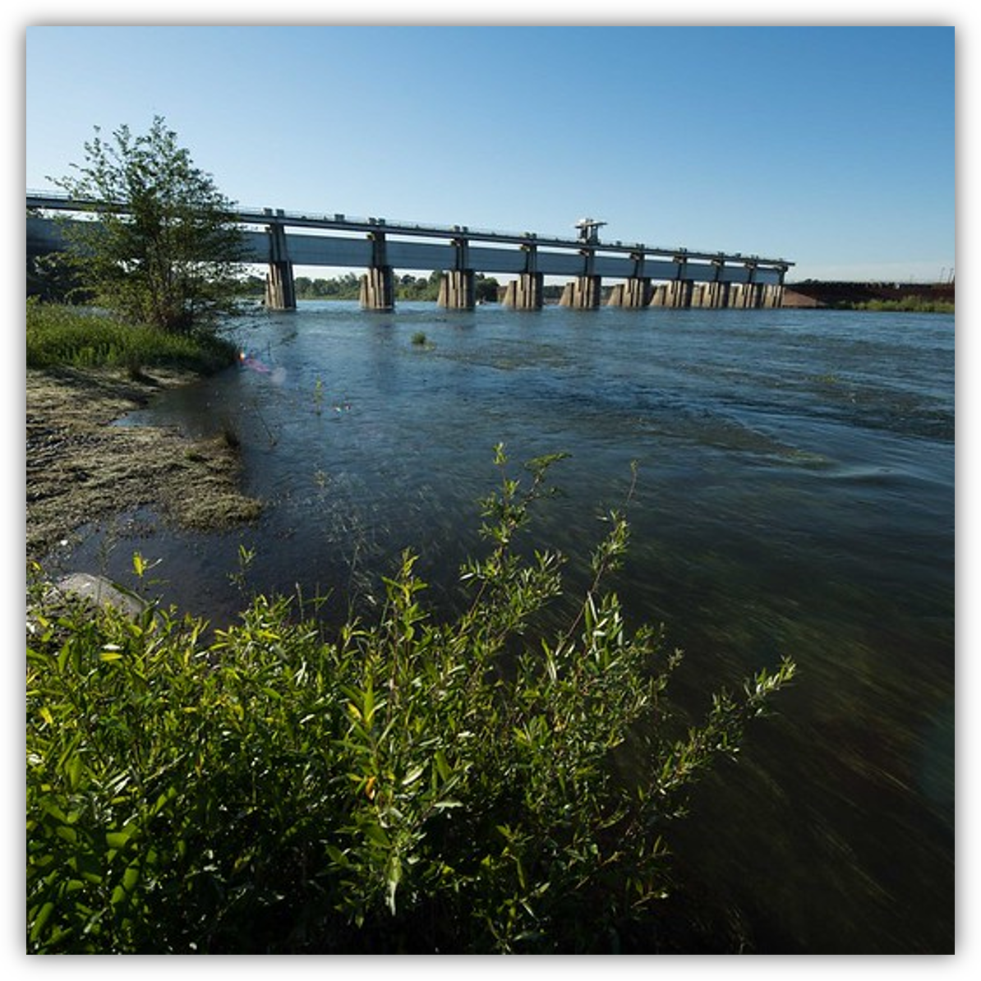
Program Overview
Program Implementation
Cooperative Watershed Management Act appropriations are allocated under two funding opportunities:
Cooperative Watershed Management Program (Phase I)
  Supports watershed group development, watershed management planning, and the design of on-the-ground watershed management projects
Enhancing Water Resources Projects (Phase II)
  On-the-ground implementation of watershed management projects.
Notes:
Funding for watershed groups is provided in phases that are designed to support watershed groups from organizational development through the successful implementation of collaboratively developed projects.

Slide 11
Funding Opportunity Overview

Slide 12
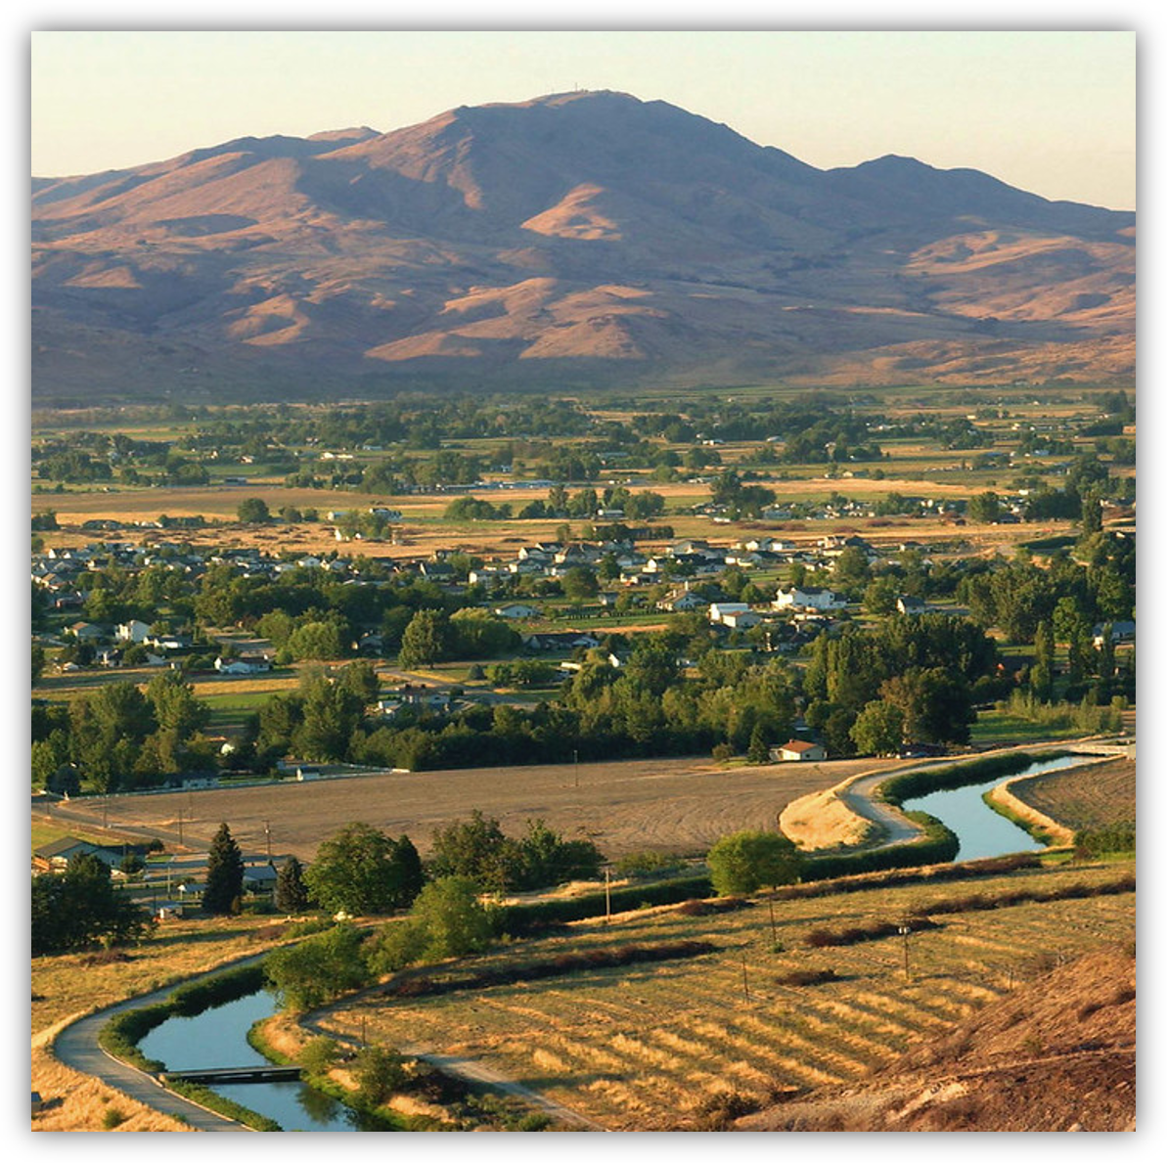

Funding Opportunity Objective
The CWMP NOFO supports the establishment and further development of watershed groups as they work to qualify for Phase II implementation funding.
Watershed group meets the statutory definition
Has approved articles of incorporation and bylaws
Holds regular meetings
Has completed a mission statement
Has developed a restoration plan and project concepts
Applications should demonstrate that the watershed group is working towards
meeting this objective
Notes:
This funding opportunity is a capacity building program

Slide 13
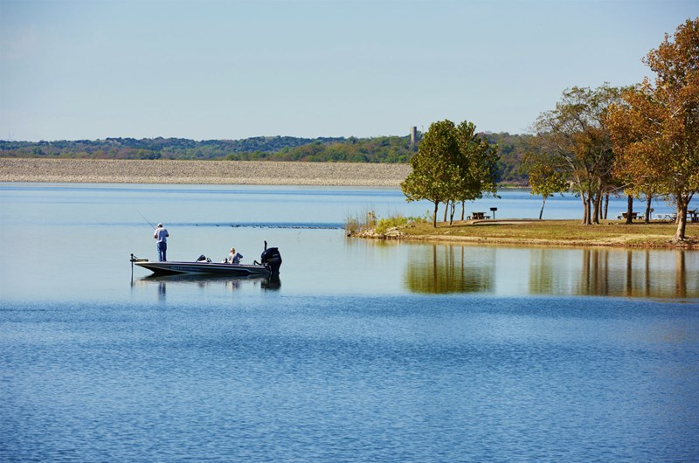
Applicant Eligibility
Existing Watershed Groups
A watershed group member or fiscal agent may apply if they are a state, Tribe, local or special district, local governmental entity, interstate organization, institute of higher education, or a non-profit organization.
Watershed groups must be located in the 17 Western States, Hawaii, Alaska, Puerto Rico, American Samoa, Guam, Northern Mariana Islands, or the U.S. Virgin Islands
Must meet the definition in the Cooperative Watershed Management Act, Section 6001(6):
  Be a grassroots, non-regulatory entity that addresses water availability and quality issues within the relevant watershed;
  Capable of promoting the sustainable use of water resources in the watershed;
  Make decisions on a consensus basis; and
  Represent a diverse group of stakeholders representing different water use sectors, including hydroelectric producers; livestock grazing; timber production; land development; recreation or tourism; irrigated agriculture; the environment; municipal water supplies; private property owners; Federal, state and local governments; Tribes; and disadvantaged communities.
Be legally incorporated as a non-profit organization

Slide 14
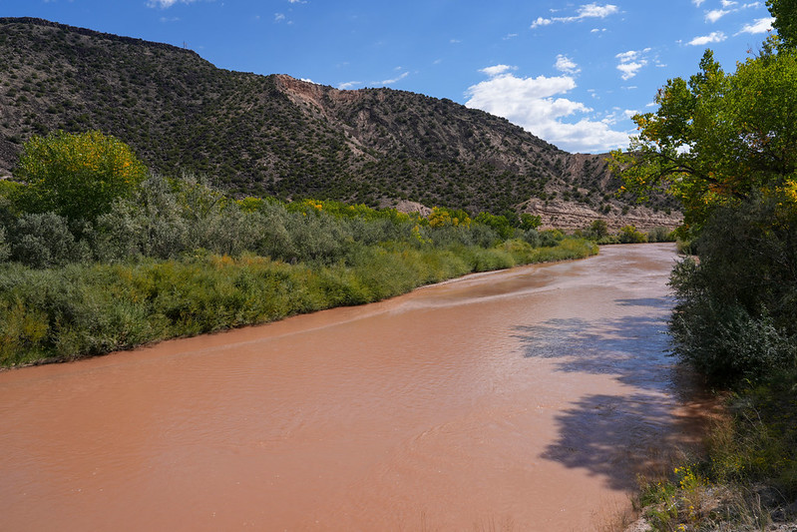
Applicant Eligibility
New Watershed Groups
Watershed groups and watershed group sponsors must be located in the 17 Western States, Hawaii, Alaska, Puerto Rico, American Samoa, Guam, Northern Mariana Islands, or the U.S. Virgin Islands
Eligible watershed group sponsors:
  States, Tribes, irrigation districts, or water districts
  State, regional, or local authorities, the members of which include organizations with water or power delivery authority
  Other organizations with water or power delivery authority.
  Institutes of higher education
  Non-profit organizations
Sponsors must also be:
  Sponsoring the establishment of a new watershed group
  Able to significantly affect or be affected by the quality and quantity of water in the watershed
  Capable of promoting the sustainable use of water resources

Slide 15
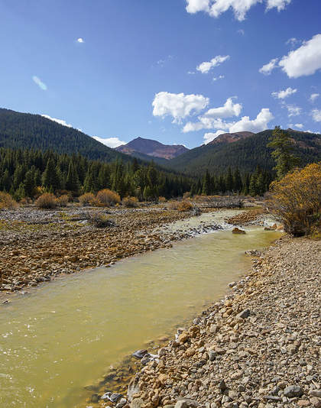
Funding
Amount
Applicants may request up to $300,000 in Federal funding for a project that can be completed in 3 years.
Non-Federal cost share is not required. Voluntary cost share of at least 5% is incentivized in the merit criteria.
Restrictions
only up to $100,000 is available each year
Recipients must demonstrate that they have made sufficient progress on their project before they have access to the next year’s funding.
Semi-annual performance reports are used to evaluate recipient progress
Notes:
Funding can be used to fund a full-time coordinator position
Administrative costs are capped at 20% under the statute.
Field work is capped at 50% of the total project cost.

Slide 16
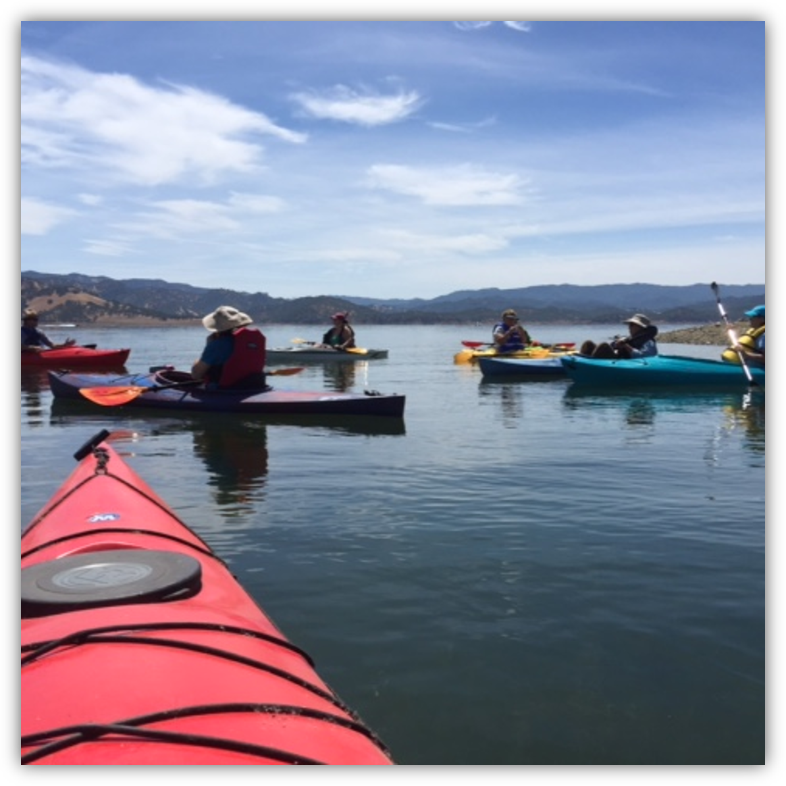
Application Periods
Submission deadlines:
  First Round: October 7, 2026
  Second Round: February 24, 2027
  Third Round: September 1, 2027
  Fourth Round: February 15, 2028
Applications must be received by 4:00 p.m. MT

Slide 17
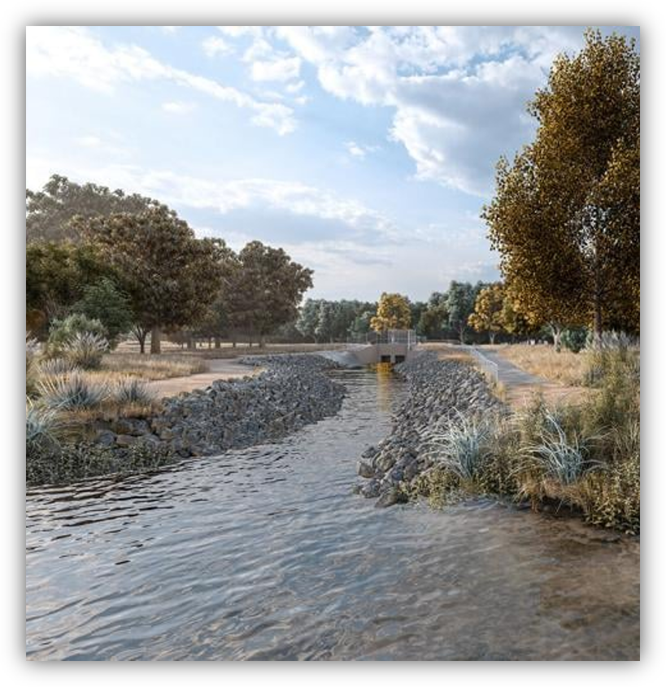
Eligible Activities
1. Watershed group development
  Conducting outreach
  Developing mission statement, vision statement, and group goals
  Developing articles of incorporation, bylaws, and business practices
  Gathering information about water issues and needs within the watershed
  Preplanning activities such as reviewing existing plans and collecting baseline information

Slide 18
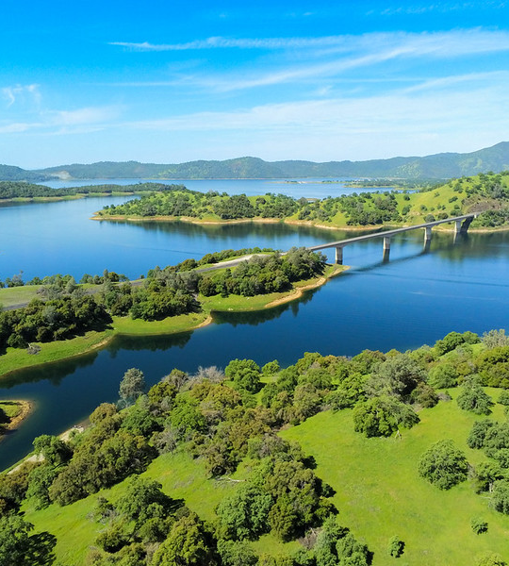
Eligible Activities
2. Watershed restoration planning
Conducting mapping, obtaining data, modelling, other technical analyses
Conducting baseline studies (e.g. water quality, water quantity, vegetation surveys, invertebrate surveys)
Developing goals or benchmarks
Completing a new or updating an existing watershed restoration plan
Developing general watershed management project concepts
Conducting an analysis to identify and prioritize specific watershed management projects

Slide 19
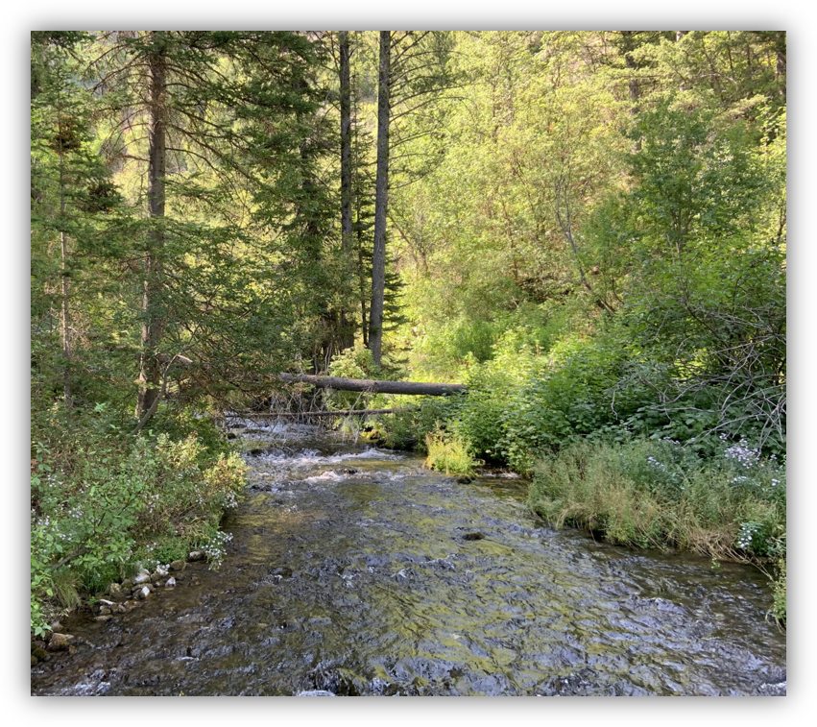
Eligible Activities
3. Project implementation planning and
design
Evaluating site alternatives to identify specific locations
Developing project requirements and evaluating design alternatives
Completing modeling, data collection, and other technical analyses to evaluate impacts of proposed restoration
Carrying out relevant studies (environmental, biological, cultural, engineering)
Preparing design drawings
Preparing cost estimates and developing a project implementation plan

Slide 20

Ineligible Activities
River clean-ups and other on-ground activities
Environmental compliance for the construction of a project
Permitting costs
General education activities
Water and land purchases, leases or easements

Slide 21
Application Content

Slide 22
Mandatory Content
        SF-424 – Application for Federal Financial Assistance
        SF-424A
        SF-LLL
        Project Narrative
        Budget Narrative
        Project Abstract Summary

Slide 23
Project Narrative
Table of Contents
Executive Summary
Project Location
Applicant Category
Eligibility of Applicant
Technical Project Description
Responses to Merit Review Criteria
Technical Project Description
Detailed description of goals and all activities
Be clear and include explanation to help the reviewer understand
If you received a previous grant, explain how this project is different

Slide 24
Merit Review Criteria

Slide 25
Merit Review Criteria Overview
Evaluation Criteria | Points
A. Watershed Group Diversity and Scope | 25
B. Developing Strategies to Address Critical Watershed Needs | 25
C. Readiness to Proceed | 15
D. Presidential and Department of the Interior Priorities | 30
E. Voluntary Cost Share | 5
Total | 100

Slide 26
Criterion A: Watershed Group Development and
Geographic Scope
This criterion evaluates the extent to which the watershed group does or will include a diverse array of stakeholders that exist within the watershed and encompass the entire geographic area of the watershed meets project will provide a variety of benefits in line with the intent of the funding opportunity.
What scores well? Applications that demonstrate the maximum diversity of interests and the entire geographic scope of the targeted watershed
Notes:
Up to 40 points may be awarded based on the evaluation of the benefits that are expected to result from the proposed restoration project.
Note: In addressing this criterion, you must clearly describe the components of your restoration project, and link the benefits to those components. Projects that clearly describe the specific restoration work and the benefits of that work will score higher under this criterion.
Projects that have a defined restoration project already defined will score best as we expect applicants to have done some prior planning even if you are a Task A: Study and Design Applicant. Otherwise very difficult to quantify the benefits
Provide documentation and support for each of your responses.

Slide 27
Criterion A: Watershed Group Development and
Geographic Scope
  Sub-Criterion A.1. Watershed Group Diversity (15 points)
  See Example Stakeholder List attachment to the funding opportunity
  What stakeholder groups are present and what are their concerns?
  If not all stakeholders are represented, what is your plan to engage them and broaden membership?
  Sub-Criterion A.2. Watershed Geographic Scope (10 points)
  Small to medium-sized watersheds (HUC-12, HUC-10, or HUC-8)
  water.usgs.gov/GIS/huc.html
  Provide a map of the watershed and noting key stakeholders and areas of work
  If your project includes site-specific restoration planning, provide a map of the site(s)
  See Example Watershed Map attachment
Notes:
New
Existing
If there are stakeholders that are not or under-represented in your watershed group, how will you engage with them or expand future outreach efforts?

Slide 28
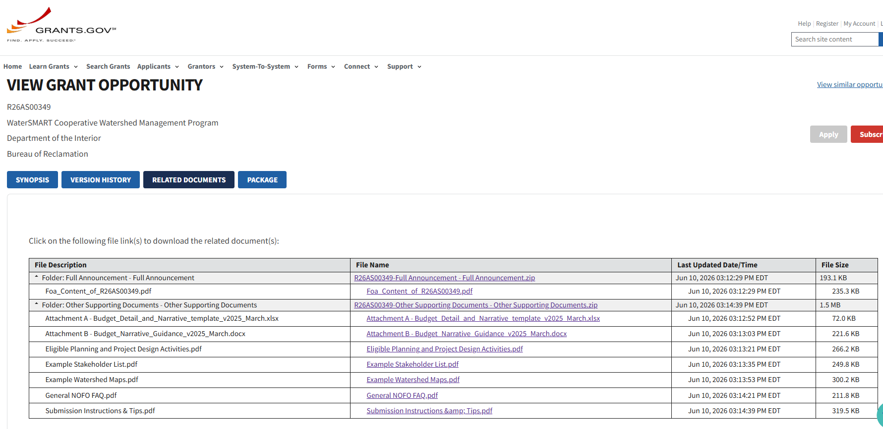


View Grant Opportunity
Notes:
The “Related Documents” tab is where you will find all the details needed to complete your application, in addition to other information and resources such as Frequently asked questions and Guidance on how to complete the Budget Narrative. Use the dropdown arrows on the left to open the folders and see each file.
They can all be downloaded to a zip file, or you can choose which documents you want to download individually.
If a modification has been made to the NOFO then the new version will be uploaded here, and you can see the Last Updated Date/time. Currently this announcement has not been modified.
Next slide please…

Slide 29
Criterion B: Developing Strategies to Address Critical Watershed Needs (25)
This criterion evaluates the extent to which the watershed has critical issues of concern and that the identified issues will be addressed by the watershed group activities identified in your technical project description.
Sub-Criterion B.1. Identifying Critical Watershed Needs and Issues (15 points)
  What scores well? Applications that include detailed qualitative or quantitative information or support that is applicable to their watershed.
Sub-Criterion B.2. Project Benefits (10 points)
  What scores well? Applications that clearly link project activities to benefits and provide support for the expected benefits.

Slide 30
Criterion C: Readiness to Proceed (15 points)
This criterion evaluates the extent to which you demonstrate
the activities within the that you understand program requirements,
can proceed with proposed activities after the financial assistance agreement is issued, and
complete project period.
What scores well? Applications with a detailed technical project description, well thought out project schedule with tasks and subtasks, and a detailed budget breakdown and narrative.
Notes:
Include a preliminary project schedule that shows:
• The major milestones for accomplishing the activities included in your technical project description.
• The stages and duration of these activities including major tasks and dates.
• The party primarily responsible for completion of each task and milestone.

Slide 31
Criterion D: Presidential and Department of the Interior Priorities (30 points)
Up to 30 points may be awarded based on the extent that the project:
advances one or more Administration priorities including E.O. 14154: Unleashing American Energy, justifies alignment with priorities and requirements in E.O. 14332: Improving Oversight in Federal Grantmaking
includes primary project elements that develop, demonstrate, and or implement artificial intelligence (AI) technologies that advance the Administration’s and Department's priorities for AI
aligns with the Secretary’s strategic objectives, including those identified in Secretarial Orders 3417 Addressing the National Energy Emergency, 3418 Unleashing American Energy, 3419 Delivering Emergency Price Relief for American Families and Defeating the Cost-of-Living Crisis
aligns with goal and objectives in the DOI’s FY 2026-2030 Strategic Plan;
supports water management and enhanced operational flexibility in Reclamation States, within with priority given to the Colorado River Basin and other basins which is experiencing long-term drought conditions
Please address only those priorities that are
applicable to your project.
Notes:
D.1. Points will be allocated based on the degree to which the project supports one or more of the priorities listed, and whether the connection to the priority(ies) is well supported in the application. provide factual support, including data and site maps
Natural resources, natural resource management
Projects that could lead to wet water being conserved in Lake Mead or any of the Colorado River Storage Project Initial Units
There are four initial storage units built as part of the CRSP:
Wayne N. Aspinall Unit in Colorado (Blue Mesa, Crystal, and Morrow Point Dams),
Flaming Gorge Unit in Utah,
Navajo Unit in New Mexico,
Glen Canyon Unit in Arizona;

Slide 32
Criterion E: Cost Share Priority (5 points)
Up to 5 points may be awarded to proposals that include voluntary non-Federal cost share contributions of at least 5 percent.
State the percentage of non-Federal funding provided using the following calculation:
Non-Federal Funding / Total Project Cost = %
See Cost Sharing Requirement and Budget Narrative for more information on cost-share requirements and eligible costs.

Slide 33
Environmental and Cultural Resource Considerations

Slide 34
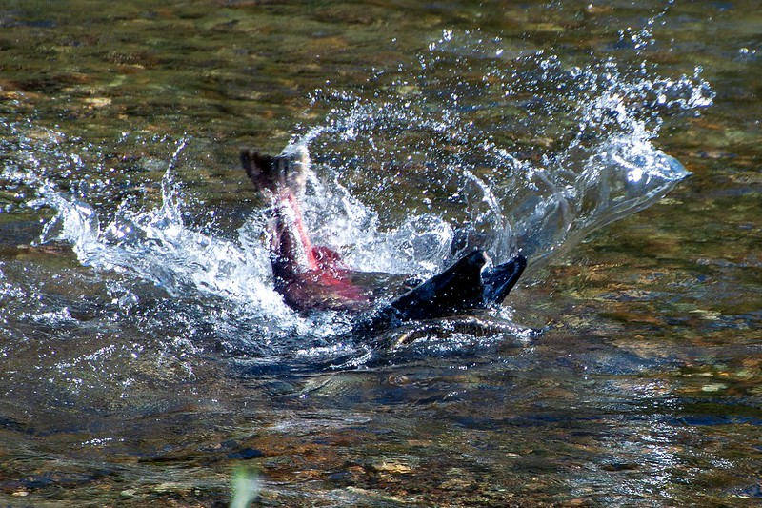
Environmental and Cultural Resource Compliance:
Preparing Your Application
All selected projects are required to comply with Federal and State environmental and cultural resource compliance laws.
Environmental and cultural compliance may be required for fieldwork, water quality or other monitoring, baseline assessments, and surveys.
Contact your local Reclamation office to discuss requirements and the associated timelines and costs.
Include a line for environmental and cultural resource compliance in your application budget.
Notes:
Even study and design projects should include a line item
Task A projects will require compliance whether you think so or not so contact your local reclamation office – may have some activities that will require a higher level of compliance than you may think

Slide 35
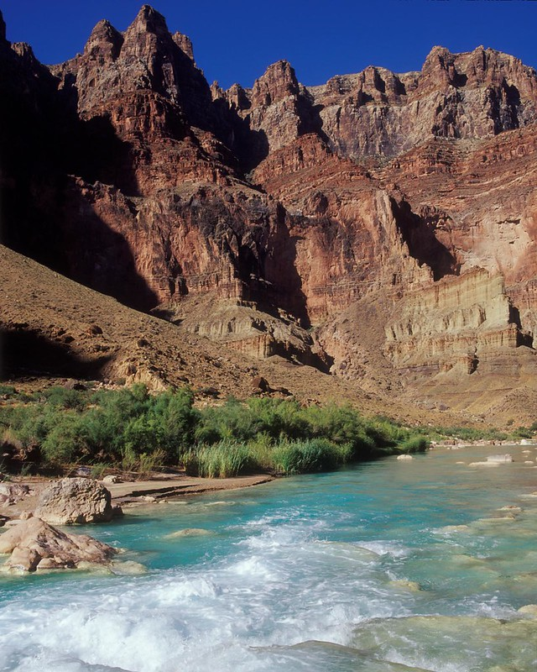
Environmental and Cultural Resource Compliance:
If Your Project is Selected
Reclamation is ultimately responsible for compliance with Federal environmental and cultural resource requirements.
Your Grants Officer Technical Representative (GOTR) will contact you after award to initiate discussions regarding compliance requirements and next steps.
You will be required to provide detailed information about your monitoring, surveys, and other fieldwork activities necessary to comply with Federal environmental and cultural resource requirements.
You must receive a notice to proceed from Reclamation before initiating any fieldwork activities requiring compliance. Not doing so will jeopardize the funding potential of your project.
Notes:
Reclamation offices have differing levels of capacity to take on compliance activities

Slide 36
WaterSMART
Financial Assistance Requirements
Notes:
Good afternoon!
My name is Randy Harris, and I’m a Grant Management Specialist with the Department of the Interior Office of Grants Management and I specifically work on Notice of Funding Opportunities Team.
Next, we’re going to talk about some things you’ll need to submit your application, go over the review process and what to expect if/when you are selected.

Slide 37
Financial Assistance (FA) Office
Primary Role of the FA Office
Answer questions during the application process
Conduct Eligibility Review and remove applications that do not meet submission requirements of the NOFO.
Notify Applicants of Application status
Notes:
The Financial Assistance Teams main role is to Answer questions about financial assistance requirements during the application process.
We conduct the Eligibility Review and remove Applications that do not meet the submission requirements listed in the NOFO.
We also notify applicants of their selection status based on the contact information provided on the SF-424 Form. Please make sure that the information submitted in the SF-424 Form is current and correct to ensure you receive all notifications.
Next slide please…

Slide 38
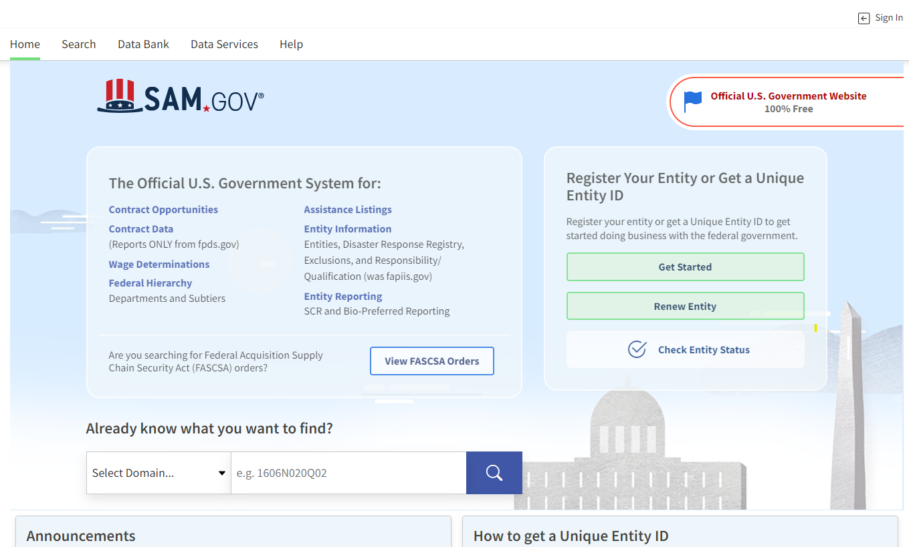

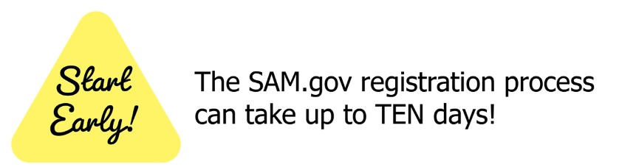

SAM.gov Registration
Where to Start
Register in SAM.gov and obtain a Unique Entity Identifier (UEI)
  SAM.gov | Entity Registrations
  Sam.gov Help Desk Information
    By phone: (toll-free) 866-606-8220. Call and live chat hours are Monday - Friday from 8am - 8pm EST
    Document Technical Difficulties, if needed
Notes:
Start your application process by visiting the System for Award Management (SAM.gov)—the official, free U.S. Government registration website for Financial Assistance.
We won’t walk through each step today, however, completing SAM.gov registration is required to be eligible for federal grants and cooperative agreements.
Once registered, your organization will receive a Unique Entity Identifier (UEI). This 12‑digit alphanumeric code, which replaces the former DUNS number, is mandatory to apply for all USBR Funding Opportunities (NOFOs)
During registration, your organization must designate an E‑Business Point of Contact, which will also be used when registering in Grants.gov.
Website addresses to the registration page and help desk resources are provided on-screen.
Keep in mind: SAM.gov registration can take up to 10 business days, so plan ahead.
Next slide please…
NEXT SLIDE

Slide 39

Register in Grants.gov
Register in Grants.gov
  Applicant Registration | GRANTS.GOV
    If you have difficulties – document communications with help desk.
  Grants.gov Help Desk Information:
    By e-mail: support@grants.gov
    By phone: (toll-free) 1-800-518-4726 (1-800-518-GRANTS). The Grants.gov Contact Center is available 24 hours a day, 7 days a week, excluding federal holidays.
Please allow up to 30 days to register and set up a workspace account.
Notes:
Once your organization has received a UEI number, you can begin the registration process in Grants.gov.
If you are a first‑time applicant, you will need to set up a new account. On the Grants.gov homepage, select “Register” in the upper‑right corner to begin.
Ensure the organization name and contact information you register with in Grants.gov is the same name and information you registered with in SAM.gov. Grants.gov validates information against you SAM.gov registration, and inconsistencies can cause delays or issues during application submission.
Registration and workspace account setup can take up to 30 days, so plan ahead.
Because Grants.gov is external to Reclamation, our ability to assist is limited. If you encounter technical issues, contact the Grants.gov Help Desk. If a problem is due to a system issue (not user error), document it and include the documentation with your application.
Next slide please…

Slide 40
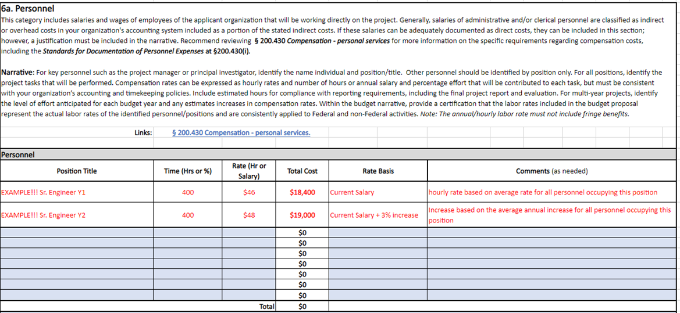
Preparing your budget
Budget Narrative is Required
There is No Required Format
We Recommend using
  Attachment A – Budget Detail and Narrative Excel (pictured)
  AND
  Attachment B – Budget Narrative Guidance
Your budget must address the Total Project Cost, which is the cost for BOTH Federal and Nonfederal expenditures.
Notes:
Preparing Your Budget
• The Budget Narrative is required. Without it, we cannot process your application.
• While there is no mandated format, any custom narrative must follow the guidance provided in Attachment B – Budget Narrative Guidance. This resource offers step‑by‑step direction on building a complete and defensible budget proposal.
• We also provide Attachment A – Budget Detail and Narrative, which we strongly encourage you to use.
– Even if you choose not to use the Excel workbook as your official submission, it is still a helpful tool for understanding how to identify and justify project costs.
– If you do complete Attachment A in full, you do not need to submit a separate Budget Narrative.
Next slide please…

Slide 41
Financial Assistance – Eligibility Review
All application packages will be screened to ensure:
Timeliness, Completeness, and Eligibility
Active Unique Entity Identifier (UEI) and SAM registration
Meets the content requirements
Contains completed and signed mandatory forms
Notes:
• Once the NOFO closes (First Round Deadline: October 7, 2026, at 4:00 p.m. Mountain Time), applications will be retrieved from Grants.gov and reviewed to ensure all requirements are met.
• During the Eligibility Review, each application is checked for:
– Timely submission
– A complete application package
– Applicant eligibility based on NOFO criteria
• The financial assistance office will also verify:
– The applicant’s UEI
– Active SAM registration
– Completion and signature of all mandatory forms
• Applications that do not meet the published requirements will be removed from consideration.
Next slide please…

Slide 42
Financial Assistance – Selection Notification
After First Level Screening: ​
  Ineligible applicants will be notified ​
  Eligible applicants will move on to the Merit Review​
​After Merit Review:​
  Successful and unsuccessful applicants will be notified ​
  Next steps for entering into a Financial Assistance award will be included​
Notifications will all come from this mailbox: Bor-sha-fafoa@usbr.gov
Notes:
• After the initial screening is completed, ineligible applicants will be notified via email, and eligible applications will advance to Merit Review.
• All notifications are sent using the contact information provided on the SF‑424 Application Form.
– If you have submitted an application and your contact information has changed, please email us so we can update our records.
• Once the Merit Review Stage is completed by the Program Office, the Financial Assistance staff will notify applicants whether or not they were selected for funding.
• To ensure you receive all communications, we recommend adding the NOFO Team email address (shown on the screen) to your safe senders list.
Next slide please…

Slide 43
Pre-award Documentation
What to expect if selected for funding
You may be asked to provide:
  Budget clarifications
  Cost-share documentation
  Explanation of pre-award costs
  All reports up to date on other Reclamation awards
**Approximately 60 days to Award**
Notes:
• If you are selected for funding, you will receive a notification letter outlining detailed next steps.
• A Financial Assistance Specialist will follow up to request any additional information needed to move toward a Financial Assistance Agreement.
• You may be asked to provide:
– Budget clarifications, and/or
– Cost‑share documentation
• Pre‑award costs are only eligible if they were incurred after the NOFO posting date and require written approval from the Grants Officer.
• If you have any active DOI grants, all required reports must be current before an award can be issued.
• An agreement may be finalized within 60 days of selection, provided the applicant responds promptly and submits all requested documentation.
Next slide please…

Slide 44
Application Advice

Slide 45
WaterSMART Selection Process: Example Schedule
NOFO Posting Phase
(18 weeks)
ARC Review Phase
(12 – 16 weeks)
Selection Phase
(6-8 weeks)
Pre-Award Phase
(3-6 months)
Project Implementation (3 years)
NOFO Posted
(May)
NOFO Closes
(September)
Management Review
Recipient provides detailed budget info, business practices, final scope of work
(March 2027-August 2027)
Recipient submits annual performance and financial reports
NOFO open for approximately >90 Days
ARC reviews and ranks proposals
Selections announced
(March 2027)
Reclamation awards funding
Entity submits final report to Reclamation
Environmental Compliance (3-12+ months)
From NOFO Closing to Award of Funding = ~10 months
Notes:
You may be asked to provide:
Additional budget clarifications
Cost-share documentation
Explanation of requested pre-award costs
All reports up to date on other Reclamation awards

Slide 46
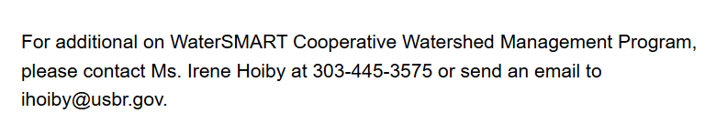
Application Tips: General Considerations
The most successful projects are those that fit well with the Notice of Funding Opportunity (NOFO) and objectives of the program
Review the objective, eligible project types, and evaluation criteria to ensure your project fits
  Look at past successful applications on the WaterSMART website
  If you have questions, book an Inquiry with program staff

Slide 47
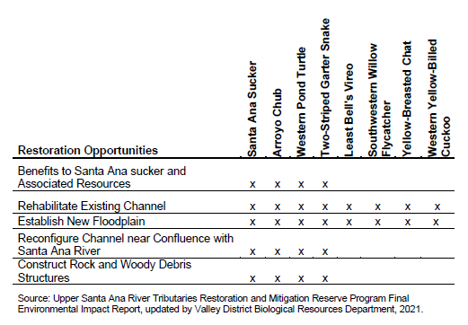
Application Tips: Evaluation Criteria
For example:
A well-organized proposal is easier to score
  Copy and paste the evaluation criteria into your application
  Use tables and diagrams to highlight specific ideas, like project benefits
Be sure to provide support for statements made in the proposal, including citations and figures
  Quantify claimed benefits whenever possible. General statements will not score well
Notes:
Added this slide with info from the EJ presentation Avra/Aiyana did – chart is from FY23 EWRP 8

Slide 48
Additional Opportunities, Tools and Resources

Slide 49
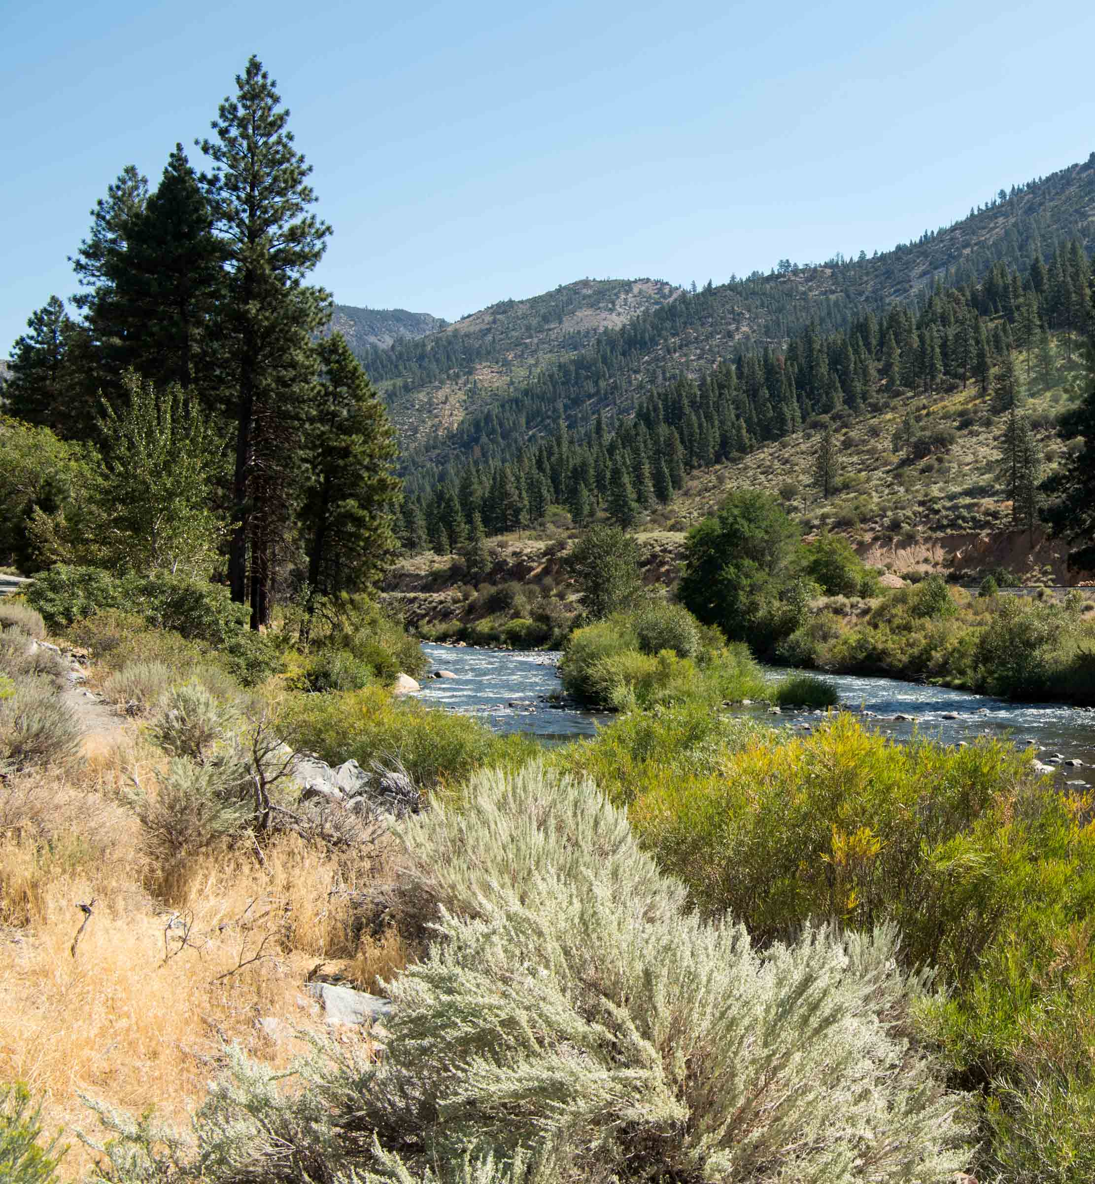
Planning and Project Design Grants
Development of a Water Strategy:
Water Marketing Strategies
Water Supply and/or Conservation Strategies
Other Water Resource Enhancement Strategies
Project Planning and Design:
Environmental Water Resources Projects
Water Management and Conservation Projects
Drought Resiliency Projects
Funding
Up to $300,000 for projects to be completed in 2-3 years
Non-Federal Cost Share: 50%
  Some Project Planning and Design projects may qualify for a 25% non-Federal cost share
Funding Opportunity Expected to Open
Fall 2026
Notes:
WSG: initial, or early-stage planning activities to develop a water strategy for the implementation of water resource activities, including outreach and collaboration, technical analyses and assessments, project scoping activities to identify and prioritize potential implementation projects, and to develop a strategy document for water supply projects, water marketing activities, water management projects, and other water resource enhancement activities
PDG: Project implementation planning and final design of medium and large-scale on-the ground water supply, water management construction and restoration projects. Prior to applying for a Project Planning and Design Grant, it is expected that applicants will have already performed some general planning work and preliminary studies that led to the identification of a specific project for design. Project Planning and Design projects should result in a final design package at a 60% design level (approximately), so that the design package can be used subsequently to apply for construction funding.

Slide 50
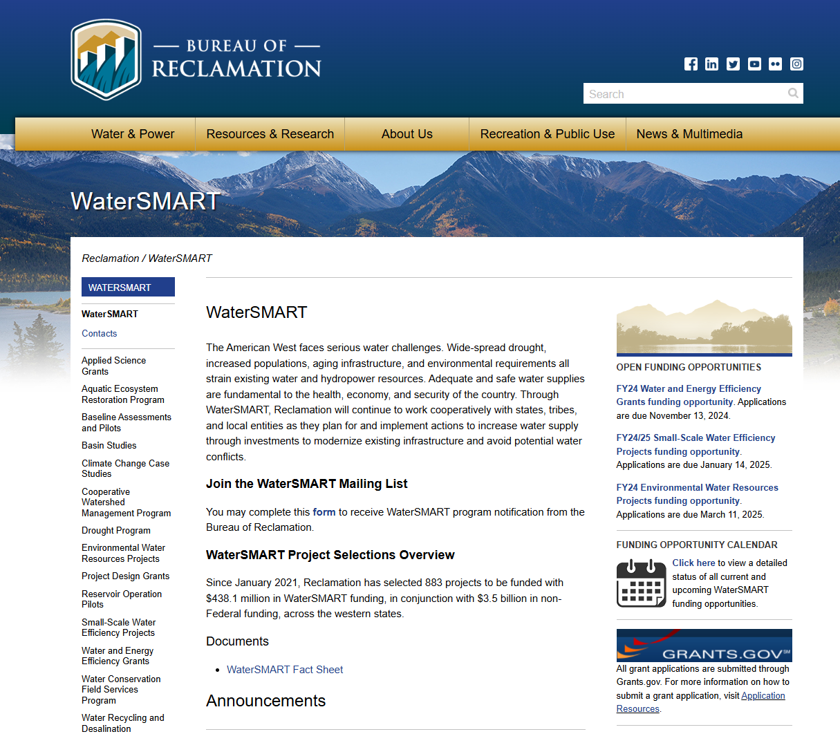

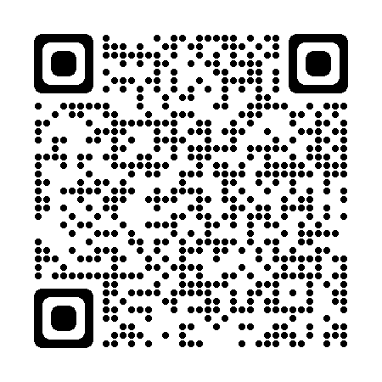
WaterSMART Program Resources
WaterSMART Program Website: https://www.usbr.gov/watersmart
  Previously funded applications for all programs
  Interactive Data Visualization Tool
  WaterSMART Dashboard
  WaterSMART mailing list
  Recent announcements
  Funding opportunity calendar
Notes:
We fully recognize that WaterSMART is a large program and can be overwhelming to navigate. Therefore we have several tools and resources available to help navigate the program. Our Website has a wealth of information for all of our programs including a status sheet that has a program description for all of our programs that includes types of projects, eligible applicants, funding available, cost-share requirements, and status of the funding.
WaterSMART Dashboard: tools related to climate change planning, BIL specific information for each funding program, calendars for the funding opportunities, and recent announcements.
No O&M
Consultation with program coordinators and always discuss why the projects are needed-that goes beyond well, it not working so we need to replace it. Talk about what happens if it isn’t replaced…
Pay close attention to opening and closing dates
Meet with program coordinators to ensure you are applying under the right program. Each program has specific project types that we are able to fund and we are more than happy to discuss your projects and point to in the right direction
Attend the webinars that we give after each funding opportunity is posted on grants.gov. Useful tips on building applications and if the time differences don’t allow you to attend, we are happy to schedule these webinars
Be sure to address the criteria in as much detail as you can
And lastly, if you apply and are not selected, schedule a debrief. We will go over your application as it relates to the criteria so you can understand what areas of the application can be improved and how they can be approved.

Slide 51
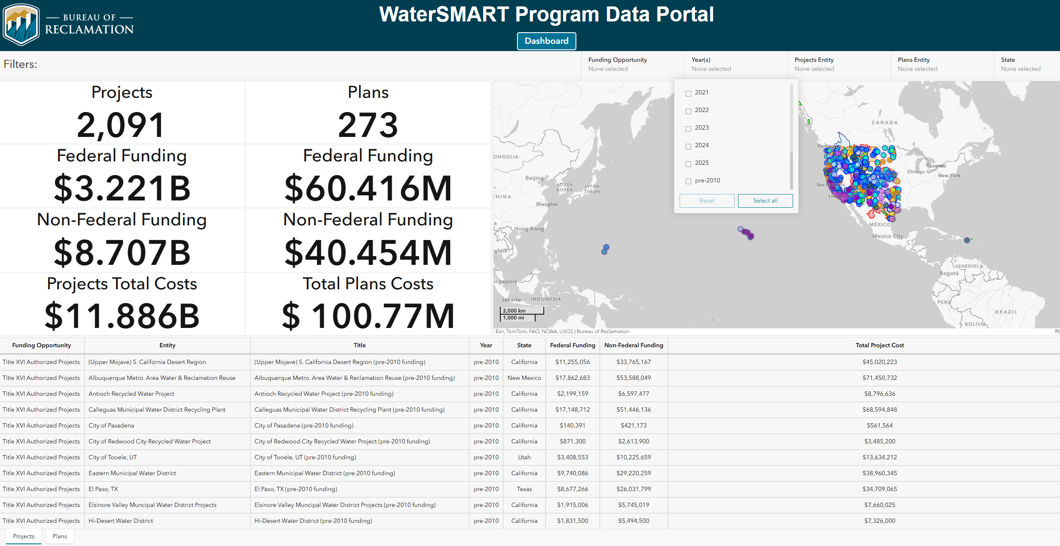
WaterSMART Program Data Portal
    Explore our interactive maps and data visualizations to browse previously funded projects.
    https://experience.arcgis.com/experience/bf5c5357e7044e0c80d5a55788d1db34/

Slide 52
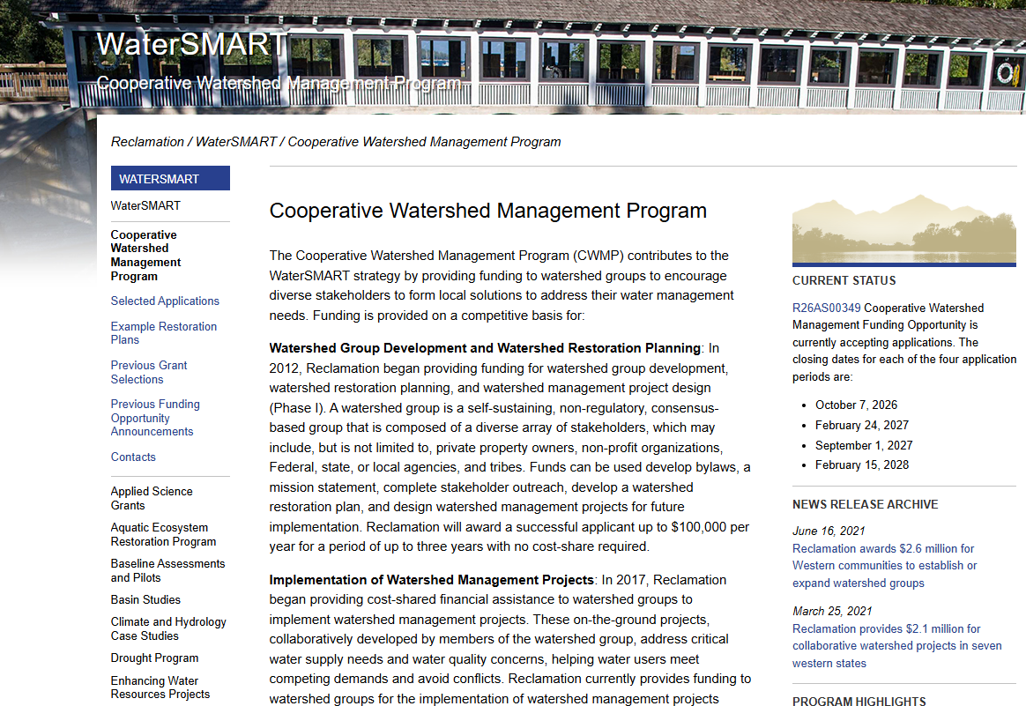
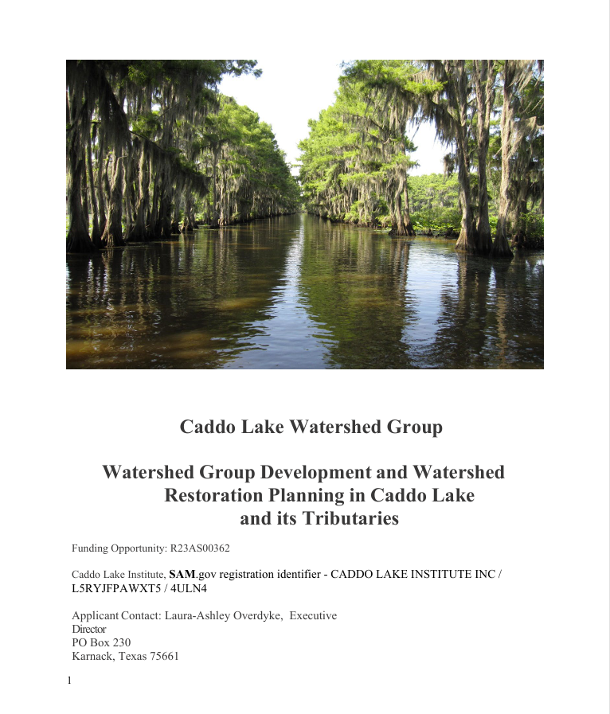
Application Tips
View previous successful applications

Slide 53
For questions relating to SF-424 forms, Grants.gov, and SAM Registration, Please email the Notice of Funding Opportunity (NOFO) Team directly at:
bor-sha-fafoa@usbr.gov
**Please copy the Program Coordinator and include the NOFO number**
Notes:
That about covers the Financial Assistance portion of the process. Please reach out to this email address for questions related to required forms or budget

Slide 54

Questions?
Use the Q&A Function or contact:
Irene Hoiby at ihoiby@usbr.gov or (303) 445-3575
Ella Vollmer at evollmer@usbr.gov
Schedule an Inquiry call with our CWMP team here: MBC-MBC-Reclamation WaterSMART Program

