Slide 1
Lower Colorado River Basin Conservation and Efficiency Program (LC Conservation Program)
​Public Webinars – June 27 and 30, 2023
The meeting will begin at 9 a.m. PDT
Join with Microsoft Teams Live

Slide 2
Webinar Agenda
Welcome and Agenda Review
Presentation
  Program Overview
  Phase 2 Funding Opportunity
  Submitting Proposals
Q&A

Slide 3
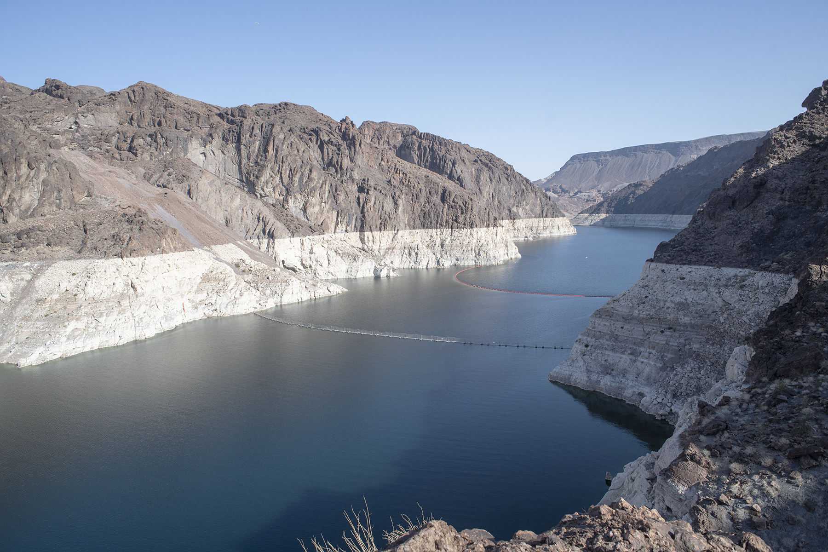
Welcome
Jacklynn Gould, Regional Director
Lower Colorado Basin
Bureau of Reclamation

Slide 4
Program Overview

Slide 5
LC Conservation Program Purpose
Part of the commitment made by the Department of the Interior on August 16, 2022, to address the drought crisis to ensure the entire Colorado River Basin can function and support all who rely on it.
Provide new opportunities for system conservation in the lower Colorado River Basin that improve system efficiency and provide durable long-term solutions.

Slide 6
LC Conservation Program Funding
Inflation Reduction Act of August 16, 2022 provides $4 billion specifically for water management and conservation efforts in the Colorado River Basin and other basins experiencing comparable levels of long-term drought.
May also use other funding authorities depending on the project type and budget needs

Slide 7
LC Conservation Program Phase 1
1.a. System Conservation at a fixed price per acre-foot: (Closed November 21, 2022)
  One-year agreement: $330 per acre-foot
  Two-year agreement: $365 per acre-foot
  Three-year agreement: $400 per acre-foot
1.b. System Conservation at a price per acre-foot as proposed by the water delivery contractor or entitlement holder. (Closed November 21, 2022)

Slide 8
LC Conservation Program Phase 2
Long-term durable system efficiency improvements that result in quantifiable, verifiable water savings in Lake Mead based on a recent history of use
  Shall result in additional volumes of water remaining in Lake Mead
Proposals should be submitted electronically to LCBEfficiency@usbr.gov no later than July 19, 2023

Slide 9
Phase 2 Funding Opportunity
Notes:
In these next few slides we’ll walk through key sections of the funding opportunity. A lot of this information is found in Enclosure 1 of the funding opportunity letter dated May 24.

Slide 10
Program Objectives
Results in quantifiable and verifiable reductions in consumptive use of Colorado River water having a recent history of use.
  Results in additional volumes of water remaining in Lake Mead.
Demonstrates viability for full implementation, including demonstrating financial and technical capability to implement and perform long-term Operations, Maintenance and Replacement (OM&R).
Monitors implementation to ensure the proposed benefits to the system are realized.
Notes:
In these next few slides we’ll walk through key sections of the funding opportunity. A lot of this information is found in Enclosure 1 of the funding opportunity letter dated May 24.
In that May 24 letter, we do list three primary objectives for proposed projects.
The first objective is that proposed projects result in quantifiable and verifiable reductions in consumptive use of Colorado River water. The reductions should be based on a recent history or use, not entitlement, and really what we’re looking for here is that the project will result in water being left in Lake Mead.
The next objective is that the proposed projects are technically and financially viable for full implementation and long-term operations.
Then the third objective is that the project can be monitored to ensure we’re actually seeing the proposed benefits to the system, for example that water is actually being left in Lake Mead.

Slide 11
Eligible Projects
Colorado River water delivery contract or entitlement holders and Central Arizona Project (CAP) water delivery contract or sub-contract holders, including partnerships with such entities, are eligible to apply.
In the case of partnership proposals, the entitlement holder must be the applicant.
Notes:
Entities eligible to apply to the program include Colorado River water delivery contract or entitlement holders and Central Arizona Project water delivery contract or sub-contract holders. Partnerships with such entities are eligible, so for example a non-entitlement holder or private entity could partner with an entitlement holder. But in those cases the primary applicant must be the entitlement holder to ensure that the project results in system conservation and reduced Colorado River water consumptive use.

Slide 12
Eligible Projects
Types of projects include, but are not limited to:
  Projects that line canals, including projects that rehabilitate aging or functionally compromised water conveyance systems.
  Agricultural upgrades and innovations, whether in technology or management.
  Urban water efficiency projects.
  Non-functional turf replacement.
  Water storage projects that allow for operational flexibilities or capturing new sources of water i.e., re-regulating reservoirs or basins.
  New technology, or existing technology used in new ways.
  Creative approaches to water markets, auctions, and/or crop switching with verifiable water savings.
  Note: In addition to traditional projects, innovation is encouraged.
Notes:
We are accepting proposals from a wide variety of projects. Really it’s almost any project that meets the program requirements and leaves water in Lake Mead. And the Federal funding for those projects is to be used for project implementation and that can include planning and environmental compliance costs. It cannot, however, include Operations, Maintenance and Replacement.
We do have some example projects listed here, but you’re not limited to this list. That said, some examples could include canal lining, agricultural innovations, urban water efficiency, turf replacement, and storage projects.
Also, in addition to traditional projects, we are also encouraging innovation.

Slide 13
Proposal Requirements
Project description and location within the Colorado River Basin.
Estimated Colorado River System water to be conserved per year and over the life of the project. Describe how it’s based on recent history of use (not entitlement).
Methodology for estimated consumptive use reduction and supporting information that documents the estimate.
Description of how to verify and document the consumptive use reduction on an annual or more frequent basis, as appropriate.
Amount of time required before system conservation begins to be stored in Lake Mead, and the duration of that benefit.
Total amount of project cost and Project Budget.
Estimated cost per acre-foot of conserved water (on either an annual basis or other proposed period of plan operation) and explanation of the proposed cost.
Notes:
This slide and the next outlines information that we’re requesting from all proposals.
That information includes a description of the project and its location within the Colorado River Basin.
It also includes the estimated amount of water the project will conserve, both per year and over the life of the project. And we ask that proposals describe how the conserved water is based on a recent history of use rather than full entitlements.
Then also please provide the methodology used to develop those estimates and any supporting information that you have available.
Next up is a description of how you propose to verify and document the consumptive use reduction that will result from your project, and how often that verification will need to take place.
Another requirement is the estimated amount of time needed until the project will be online and until water will be left in Lake Mead, as well as how long the project is expected to contribute water to Lake Mead.
Then the total expected project cost and a budget. For that, we do provide a budget template at the end of enclosure 1 in the funding opportunity letter.
And with that cost estimate we’d also want to see the estimated cost per acre-foot of the project water with an explanation of that cost. Typically we’d expect this cost-per-acre-foot term to be on an annual basis but if it makes sense to provide it on a different proposed period then you can do so, just be sure to explain it.

Slide 14
Proposal Requirements (continued)
Complete description of how the proposed plan will ensure that the amount of conserved water to remain in Lake Mead will not be ordered by other entitlement holder(s), for example, through third party consents or forbearance agreements.
Any additional information to explain and aid understanding of the proposal.
Flag any trade secrets and financial information that should be kept private, should proposals be made available to the public.
Note whether you have previously participated in existing conservation programs and/or Phase 1 of the Lower Colorado Basin System Conservation and Efficiency Program
Notes:
Other requirements include a plan of how the amount of conserved project water will remain in Lake Mead and will not be ordered by other entitlement holders, for example if third party consents or forbearance agreements are needed.
Then also if there’s any additional information needed to explain your project or help us understand the proposal you’re welcome to include that as well.
Also, please be aware that proposals may be made available to the public at some point, so if there are any trade secrets or financial information that should be kept private, be sure to flag that.
Then lastly, we are considering an applicant’s previous participation in existing conservation programs and/or Phase 1 of the LC Conservation Program, so please note in your proposal if you participated in those.

Slide 15
Technical Proposal Considerations
Consideration A – Quantifiable Water Savings
Consideration B – Economic and Environmental Benefits
  Sub-consideration B1 – Cost Effectiveness
  Sub-consideration B2 – Environmental Benefits
Consideration C – Disadvantaged Communities
Consideration D – Cost-sharing/Partnerships/Obligations
Consideration E – Readiness to Proceed
Notes:
Next up we’ll go over the technical proposal considerations.
In the next few slides I’ll go into more detail on each of these, but in total we have five main considerations. Those are quantifiable water savings, economic and environmental benefits, disadvantaged communities, cost-sharing/partnerships and obligations, and readiness to proceed.
When responding to these considerations in your proposal, keep in mind the program objectives, which again are to reduce consumptive use of Colorado River water, demonstrate project viability, and be able to monitor the project and its proposed benefits.

Slide 16
Consideration A – Quantifiable Water Savings
Describe:
  Anticipated consumptive use reduction
  Impacts to any downstream users
  How the reduction in consumptive use will be verified
  Innovation in technology or project approach
  How the project reduces dependency on Colorado River water
Notes:
Consideration A is quantifiable water savings. Under this consideration, we’re looking for the amount of water savings from the proposed project, both in acre-feet per year and as a total amount over the life of the project. Be sure to include the amount of time the project is expected to leave water in Lake Mead. You can provide a range for the water savings estimates, but if you do please explain why there’s some variability.
Under this consideration we’re also asking applicants to describe any potential impacts of their project on downstream users. For example, will water savings from this project make less water available to downstream users.
We also ask you to describe how the consumptive use reduction from the project will be verified.
Then if the project is innovative we have a few prompts for you to respond to there, such as extent to which the project is innovative, how it differs from current solutions, and how it will advance knowledge to support other projects.
Then we also ask under this consideration to describe if the project will reduce dependence on the Colorado River to increase resilience.

Slide 17
Consideration B – Economic and Environmental Benefits
Sub-consideration B1 – Cost Effectiveness
  Cost per acre-foot of water expected to be conserved in Lake Mead
  Reclamation will calculate the cost per acre-foot of water produced by the project using information provided
Sub-consideration B2 – Environmental Benefits
  Any environmental benefits (for example, ecosystem benefits or benefits to habitat or species) that may occur
Notes:
For Consideration B, we’re asking you to describe economics and environmental benefits from the proposed project.
Sub-criterion B1 is cost-effectiveness. Here, we’re asking applicants to provide the cost per acre-foot of the conserved water. When calculating this, please use costs related to the entire project that’s described in the proposal, not just an individual phase or component. We also ask applicants to provide specific information to support a cost per acre-foot calculation by Reclamation. This includes the estimated construction cost by year, the planning and design costs, and timing for the conserved water being left in Lake Mead.
Sub-criterion B2 is environmental benefits. These could be ecosystem benefits or benefits to habitat or species. If the project does provide these benefits, we ask for a description and qualitative discussion of any economic impacts from those benefits. Also if the project provides water or habitat for Federally listed threatened or endangered species then provide that explanation too.

Slide 18
Consideration C – Disadvantaged Communities
Describe if the project benefits disadvantaged communities as identified by the Climate and Economic Justice Screening Tool (CEJST) or geographically dispersed disadvantaged communities
  CEJST: https://screeningtool.geoplatform.gov/
  Benefits can include, but are not limited to, economic growth opportunities and public health and safety.
Notes:
Consideration C covers benefits to disadvantaged communities.
To identify geographically disadvantaged communities, we ask that you use the Climate and Economic Justice Screening Tool. A link to that tool is provided on this slide and also in the funding opportunity letter.
This consideration also includes benefits to geographically dispersed disadvantaged communities though, which would not be identified in the screening tool.
Here, Benefits to disadvantaged communities could include but are not limited to economic growth opportunities and public health and safety.

Slide 19
Consideration D – Cost-sharing/ Partnerships/Obligations
Describe any partnerships involved.
Describe any cost-sharing and the federal vs. non-federal portion of the costs.
  Cost sharing is not required but will be considered when evaluating proposals
Describe if the project helps address Bureau of Reclamation’s legal and contractual obligations or supports other governmental initiatives.
Notes:
Consideration D covers cost-sharing, partnerships, and obligations.
We do want applicants to leverage partnerships , so If the project does so then describe that here.
Cost-sharing is not required, but if your project does include any cost-share or leverage other funding sources that that is something we’ll take into consideration so be sure to describe that.
The lastly under this consideration be sure to let us know if the project helps address Reclamation’s legal or contractual obligations beyond the water conserved in Lake Mead. Examples here could be providing water for Tribes, water rights settlements, river restoration, or other obligations you think would be addressed. Then let us know if the project supports any other governmental initiatives such as a regional or state water plan, or an integrated resource management plan.

Slide 20
Consideration E – Readiness to Proceed
Summarize the tasks necessary to complete the project.
Describe any permits or other administrative approvals that will be required, along with the process for obtaining such.
Identify and describe any engineering or design work performed specifically in support of the proposed project.
Include an estimated project schedule and timing for implementation.
Indicate whether the project can be phased, replicated elsewhere, or scaled depending on available funding.
Notes:
Consideration E, which is the last consideration, is Readiness to Proceed.
What we’re looking for here is the capability of the project to proceed upon selection and upon entering into a water contract or financial assistance agreement.
Information we’re looking for under this consideration includes a project schedule and a description of the tasks necessary to complete the project, any permits or approvals that would be required, any engineering or design work needed, the time it will take to implement the project, and whether or not the project can be phased or scaled depending on funding availability.

Slide 21
Federal Award Information
Water Contracts Information
Financial Assistance Agreement Information
  Register with the System for Award Management (SAM)
  Obtain a UEI Number
  Administrative and National Policy Requirements
  Automated Standard Application for Payments Registration (ASAP)
Notes:
The funding mechanisms we’re looking to use under this program would be water contracts or financial assistance agreements. The type of funding agreement will depend on project specifics and will be determined on a case by case basis. We do provide information on these agreement types in Section E of the funding opportunity. But we’re not asking you to make any determination here, this is something we’ll work with you on if your project is selected for funding.

Slide 22
Environmental Compliance Information
All Projects being considered for award funding will require compliance with NEPA
To assess the probable environmental and cultural resources impacts and costs associated with each application, all applicants must respond to the Environmental and Cultural Resources Considerations questions focusing on NEPA, ESA, and NHPA requirements.
  If any question is not applicable to the project, please explain why.
Notes:
All projects that are selected will be require NEPA compliance, and because of that we do ask you to respond to the environmental and cultural resources questions that we list in section F.2 of the funding opportunity letter. Not every question will be applicable to every project, so in those cases just respond that it’s not applicable and briefly explain why.
A few examples of the type of information we’re looking for includes a description of any ground-disturbing work, any Federal threatened or endangered species in the project area, if there are any archeological or cultural sites in the proposed project area, if there are any environmental justice concerns, things like that.

Slide 23
Project Proposal Template
A suggested template is provided as Section G of Enclosure 1 in the funding opportunity letter
If the proposal will exceed 25 pages, please contact the LCB Conservation Team at LCBEfficiency@usbr.gov to request an exemption to the page limit.
Font size should be at least 12 points, and pages should be 8 ½ by 11 inches with 1-inch margins.
Flag any trade secrets and financial information that should be kept private, should proposals be made available to the public.
Notes:
The last section of enclosure 1 in the funding opportunity letter is a proposal template. You’re not required to use this template, but it is suggested.
We also include information about page limits, font size, and margins here. We do ask that you limit the proposal to 25 pages. That said, we realize that we are requesting a lot of information, so if you think you’ll need more than 25 pages, please send us an email at LCBEfficiency@usbr.gov to request a page limit exemption. In your email just provide a brief explanation on why you need more pages.
We also ask that you use at least 12 points for font size, and keep pages to the standard 8 ½ by 11 size with 1-inch margins. This is to help readability for our review team. Again, if you think you need an exemption to these requirements, please send us an email with a brief explanation.
We’ll also accept supplementary materials if you need those to help support information submitted in your proposal.
Also, please be sure to flag any trade secrets or financial information that should be kept private should proposals be made available to the public.

Slide 24
Submitting Proposals

Slide 25
Submitting Proposals
If you are interested in participating in the LC Conservation Program Efficiency projects, submit your proposal electronically by July 19, 2023, to: LCBEfficiency@usbr.gov
Funding Opportunity:
  https://www.usbr.gov/inflation-reduction-act/docs/Funding-Opportunity-River-LC-Basin-Conservation-Efficiency-05-24-2023.pdf
To the extent permissible by applicable law all proposals will remain confidential until the plan agreements are executed, thus preserving the competitive nature of the selection process.
Notes:
Proposals are due by Wednesday, July 19. Please submit them electronically to LCBEfficiency@usbr.gov.
The funding opportunity letter dated May 24 provides all of the information that we presented today. It’s on our LC Conservation website, and we have a direct link to it shown on the slide here.
If you have any questions that we’re not able to answer today, or if you want to discuss project specifics, please feel free to send us an email at LCBEfficiency@usbr.gov.
In addition, we anticipate the proposal evaluation process to be iterative, where we work with entitlement holders to refine any necessary aspects of their proposals, as long as they’re submitted by the July 19 deadline.
Also one more thing to note, is that we will keep proposals confidential to the extent permissible by applicable law, at least until project agreements are executed, to preserve the competitive nature of the selection process.

Slide 26
Q&A
For more information visit:
https://www.usbr.gov/lc/LCBConservation.html
Submit proposals by July 19, 2023 to: LCBEfficiency@usbr.gov

Slide 27
Thank you for joining us
For more information visit:
https://www.usbr.gov/lc/LCBConservation.html
Submit proposals by July 19, 2023 to: LCBEfficiency@usbr.gov

