Slide 1
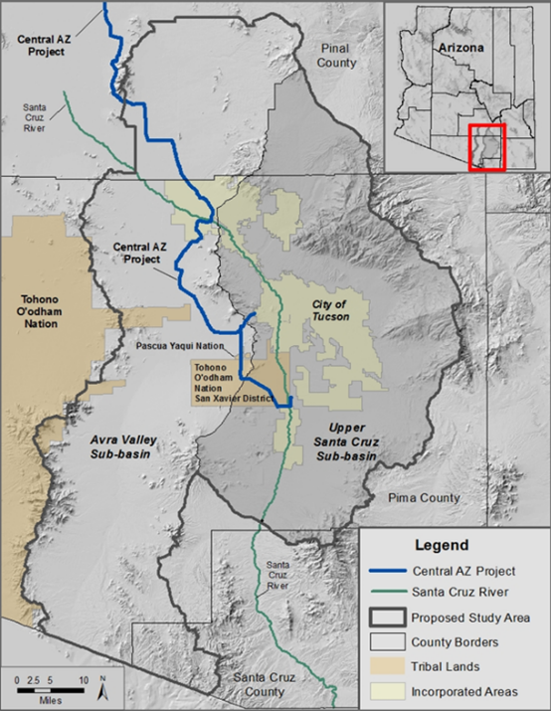
Lower Santa Cruz River Basin Study:
Review of Study Tasks and Accomplishments
Eve Halper,
Natural Resources Specialist
Bureau of Reclamation
Project Team Meeting
January 19, 2018
Notes:
Title Slide

Slide 2
Study Process
Step 1
Step 2
Step 3
Step 4
Project imbalances
Evaluate Risks
Adaptation strategies
Trade-off analysis
Future without
Additional Adaptation
Future with
Additional Adaptation
Present
Present
Assumptions about the future affecting supply and demand, encompassing a range of risk levels
Benefits and Costs
Notes:
Today I want to take a giant step back to the overview of the study. We are still working on the “project imbalances” stage of the study.
I want to return to the idea that we don’t know what the future will be like, so we need get a sense of the range of possibilities, in order to design adaptation measures.
A key decision to be made in the study is the assumptions that will affect the supplies and demands used in the hydrologic modeling. You’ve already seen the demand scenarios that have been developed. Now we are working on one aspect of supply, the future climate conditions that will determine the amount of local water supply. I use the term local to distinguish runoff from rainfall from the CAP water we import from the Colorado River

Slide 3
Supply-Demand Scenarios
Best Case (Lower Risk)
ü
High Supply
Water Supply
High Supply
Low Demand
High Demand
Water Demand
!
Low Supply
Low Supply
Low Demand
High Demand
“Worse” Case (Higher Risk)
Notes:
Our group agreed to focus on the range of risks – specifically a high supply, low demand situation, which we are calling “best case”, and a low supply, high demand, situation we are calling “worse” (not “worst” case). We use the term “worse” to indicate that this should still be a future that we can adapt to. If we can’t adapt to it, there’s not much point in proceeding with the study.

Slide 4
Scenarios Focus on Risk
“Base Case”
(w/o Climate Change)
“Best Case”
“Worse Case”
Supply and Demand
Supply and Demand
Supply and Demand
Low Risk
High Risk
Notes:
Another way to look at this is as a continuum of risk, from high to low. We will also have a “without climate change” case to separate the effects of climate change from others like growth.

Slide 5
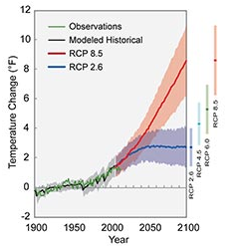
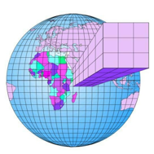
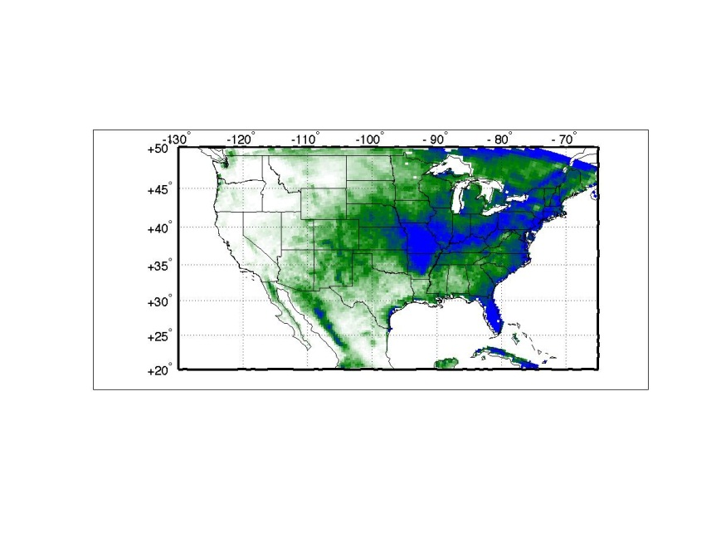
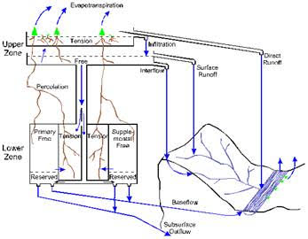
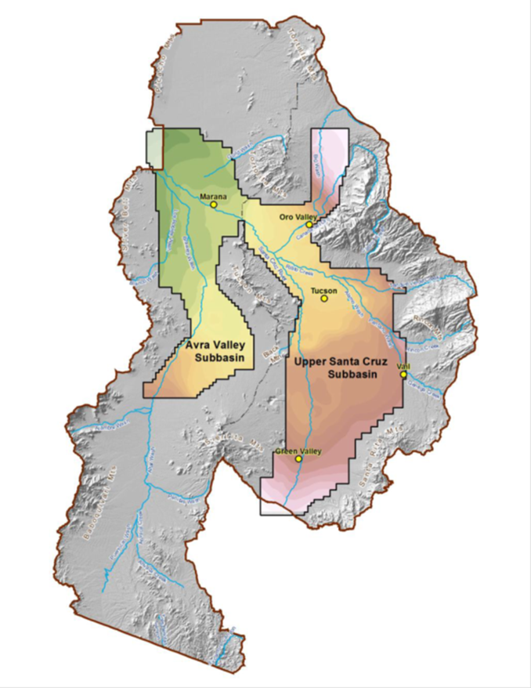
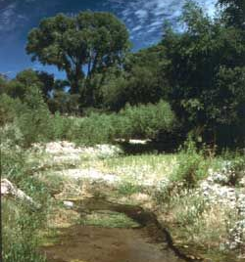
LSCR Basin Study General Modeling Methodology
RCP 8.5 (“Higher Risk”)
RCP 4.5 (“Lower Risk”)
Global Climate Model
Downscaled Climate Model
Emissions Scenarios
Surface Hydrology Model
Riparian Conditions
TAMA GW Model
Notes:
One big unknown is the level of greenhouse gasses that will be emitted in the future. The Intergovernmental Panel on Climate Change has developed a range of “emissions scenarios”. They are also called representative concentration pathways, or RCPs. Right now the RCP 4.5 scenario is considered a low emissions scenario, RCP 8.5 is considered a high emissions scenario.
These standard scenarios are used by climate modelers, so that models can be compared “apples to apples”.

