Slide 1
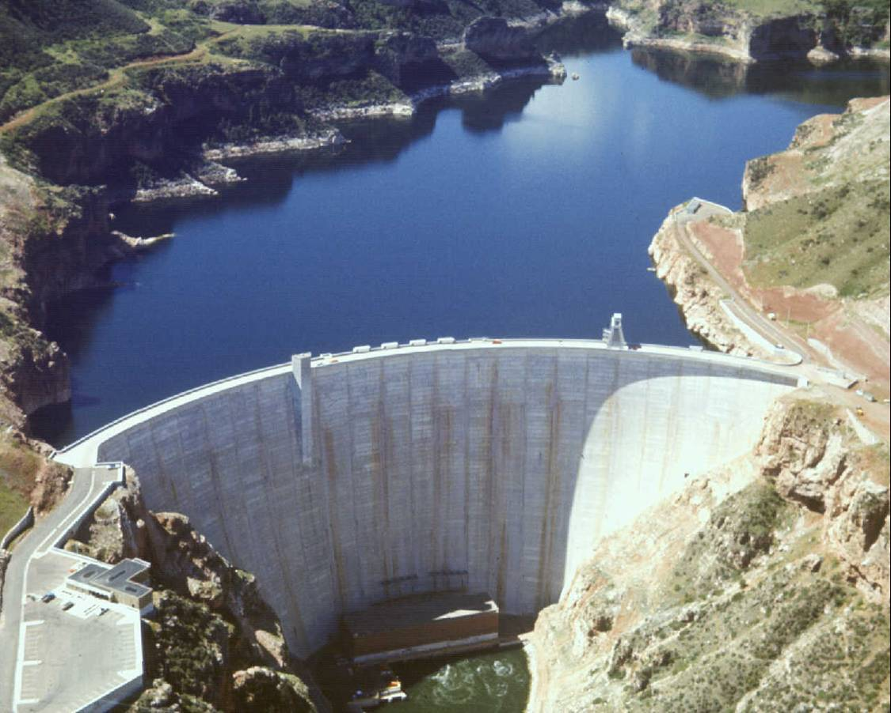
RECLAMATION
Managing Water in the West
Yellowtail Dam & Bighorn Lake Operating Criteria Review
Billings, MT
September, 2010

Slide 2
Bighorn Lake Operations
Revised Operating
Criteria Review

Slide 3
RESERVOIR TARGETS
Date Existing Proposed Difference
_______ Targets Targets (feet)
Oct 31 3635 3638-40 +3-5 ft
Nov 30 3630 Eliminated
Mar 31 3605-14 3617-21 +7-13 ft
July 31 3640 3640 Same

Slide 4
Nov-Mar Release Calculation
Water Balance Equation Used to Calculate Nov-Mar Release Rate Based On:
  Nov-Mar Release from Buffalo Bill and Boysen Reservoirs
  Forecasted Nov-Mar River Gains
  Draft Reservoir to near Elevation 3617-3621 by March 31
  Preference to River Flow before reducing releases below 2000 cfs
  Preference to Lake Level before increasing releases above 2500 cfs
  Minimize reductions in River Release.

Slide 5
2009 Rule Curve using Actual Inflow

Slide 6
Spring Runoff Forecasts
April-July Inflow % of
Date Forecast (ac-ft) Average
Feb. 1 634,000 57%
Mar. 1 591,000 53%
Apr. 1 625,000 56%
Apr. 15 730,000 65%
May 1 900,400 81%
May 15 1,121,400 101%
June 1 1,263,300 113%
Actual 1,504,354 135%

Slide 11
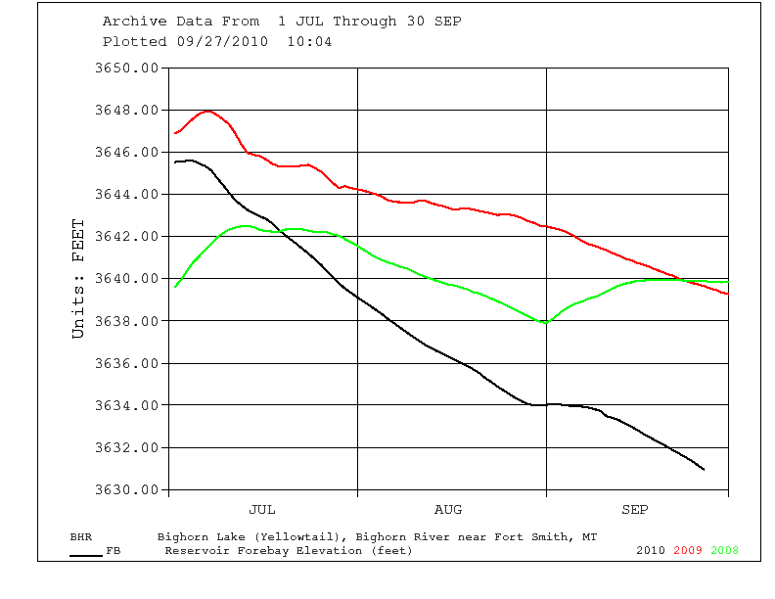

Slide 12
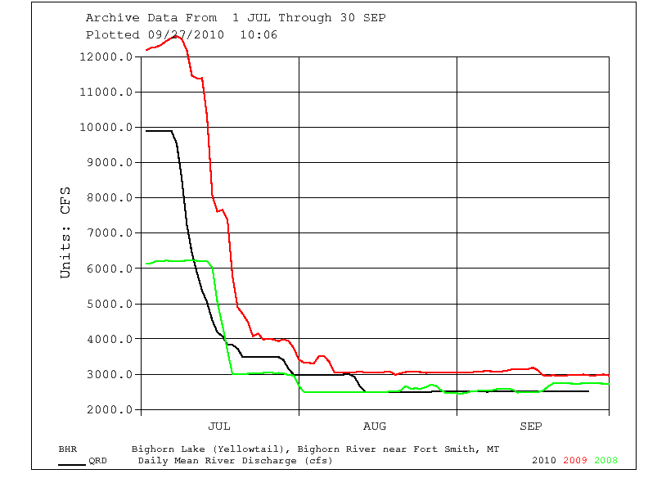

Slide 13
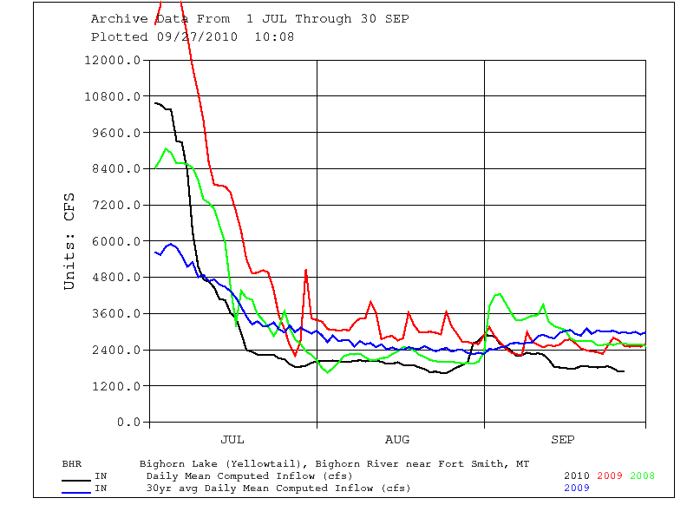

Slide 14
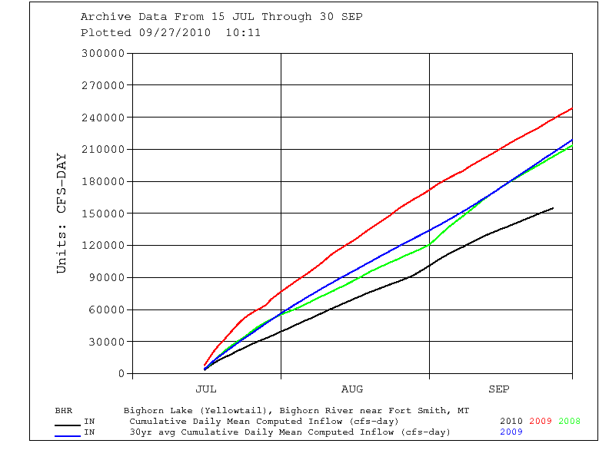

Slide 15
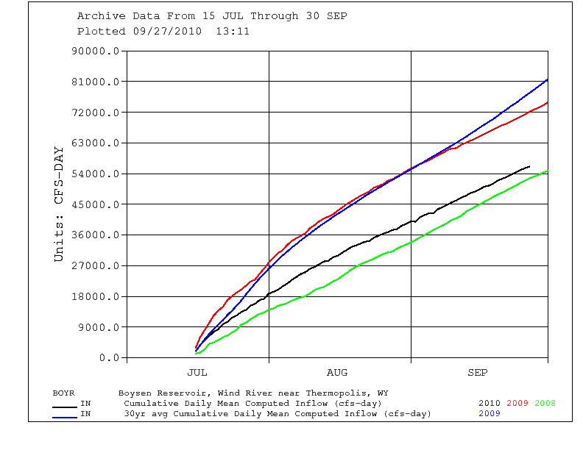

Slide 16
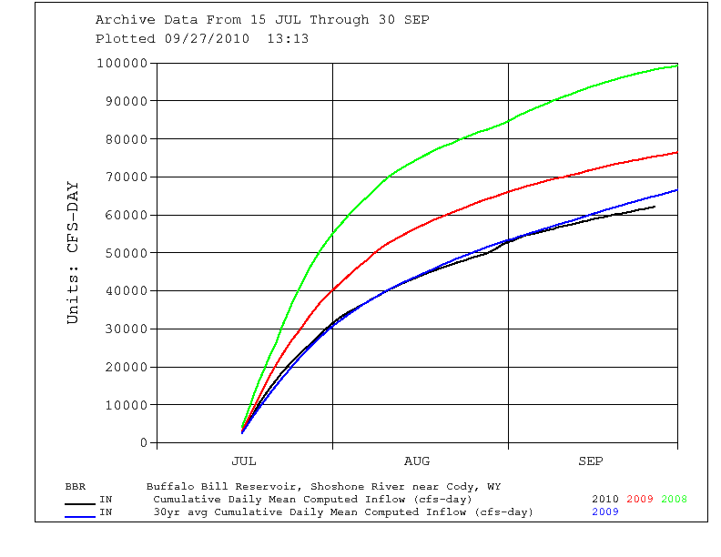

Slide 17
End of September Storage
Storage Lake Elev.
Water Yr Acre-feet Feet
2011 965,000 (est) 3630.5 (est)
2010 1,060,795 3639.3
2009 1,067,768 3639.8
2008 956,743 3629.7

Slide 18
Nov-Mar River Release Spreadsheet

Slide 19
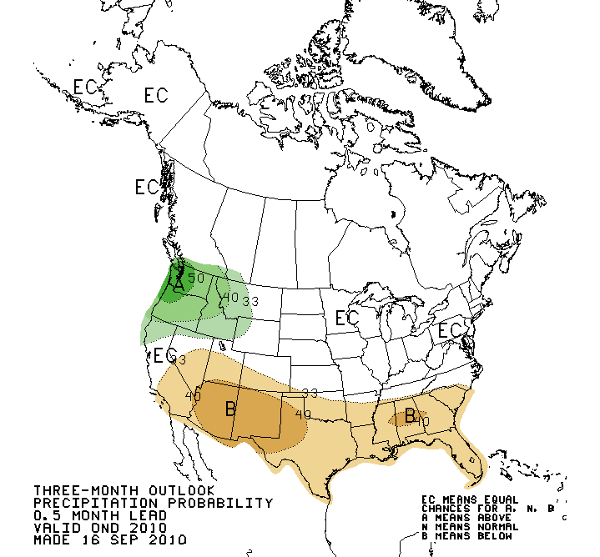

Slide 20
QUESTIONS & COMMENTS

