Slide 1
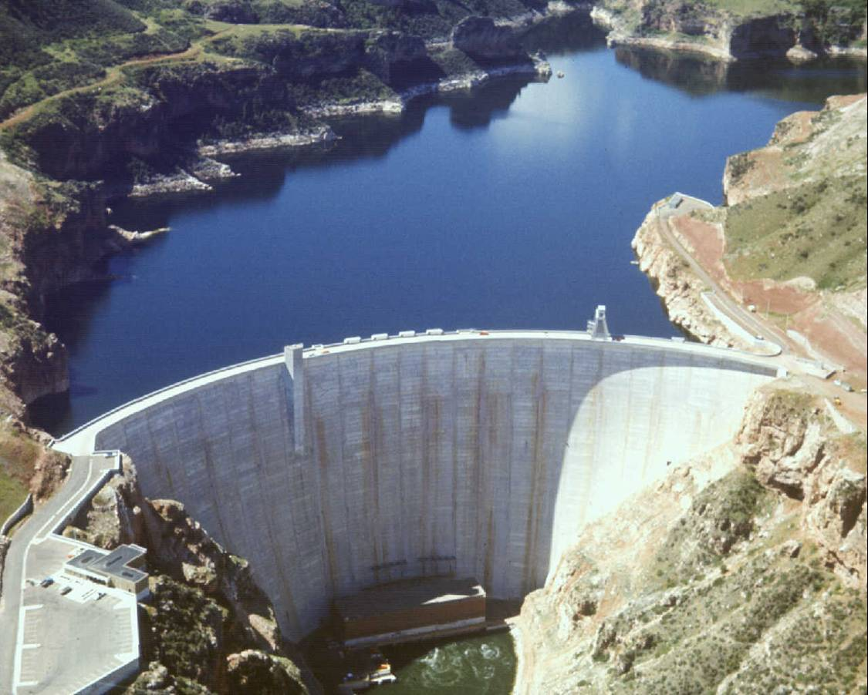
RECLAMATION
Managing Water in the West
Yellowtail Dam & Bighorn Lake
Climate Change
Billings, MT
September, 2010

Slide 2
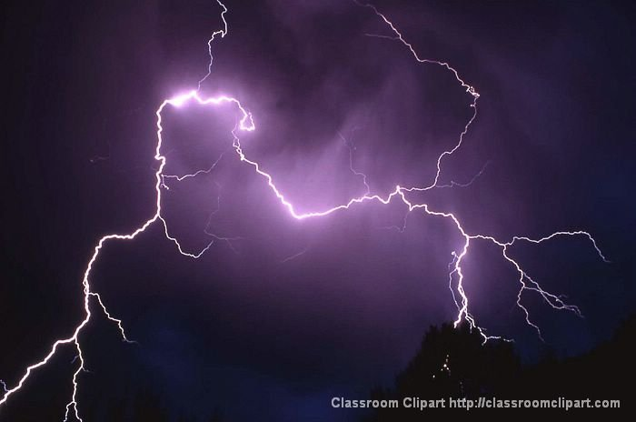
PREDICTING FUTURE CONDITIONS

Slide 3
Climate Change Models & Scenarios
No one single answer but rather a range of possibilities.
Looking ahead 30 years into the future
A number of different climate models are being reviewed and results compared.
5 different potential climate change scenarios evaluated under Study
Both timing and volume of runoff are important factors to consider

Slide 4
Buffalo Bill Average Annual Inflow

Slide 5
Boysen Average Annual Inflow

Slide 6
Bighorn Lake Average Annual Gains

Slide 7
QUESTIONS & COMMENTS

