Slide 1
FY 2019 President’s Budget Stakeholders Briefing
February 12, 2018

Slide 2
They FY 2019 budget continues to support Reclamation’s mission
The mission of the Bureau of Reclamation is to manage, develop, and protect water and related resources in an environmentally and economically sound manner in the interest of the American public.

Slide 3
Reclamation in the West
Shasta Dam, California, MP Region
Reclamation’s budget continues to address water supply challenges in the West to ensure water reliability, efficient generation of energy, celebration of America’s recreation opportunities, commitments to tribal nations, and environmental responsibilities. The 2019 budget prioritizes funding where it most effectively implements Reclamation’s management responsibilities for providing water and generating power in the West.

Slide 4
Planning for our Future
Water Reliability
Water reliability is a key cornerstone of the Reclamation mission
Maintaining efficient water supplies that ensure a safe and sound infrastructure, ensure treaty agreements and tribal obligations are met, meet environmental standards all play a critical role
Efficient Energy Generation
As the Nation’s second largest producer of hydroelectric power, Reclamation’s projects and programs constitute an important driver of economic growth
Maintaining and modernizing hydropower infrastructure to improve generation efficiency and reliability and improve cost effectiveness is a high priority. Significant funding is provided directly by power customers and Western and Bonneville Power Administrations

Slide 5
Planning for our Future (cont.)
Recreation Access
Many Reclamation projects provide multi-purpose water resource development benefits, including recreation
Recreation areas developed represent today some of the most popular areas for water-based outdoor recreation activities
Conservation
Theodore Roosevelt, sometimes referred to as the “conservationist president”, established a legacy through land and wildlife conservation
Endorsing those principles, Reclamation strives to ensure future water delivery and power generation through the responsible use and conservation of its resources
Water storage studies are ongoing to determine where resources can be focused now to deliver a broad return later; the WaterSMART and R&D programs continually strive to discover more efficient use of our resources

Slide 6
FY 2019 President’s Budget (dollars in thousands)
^{1/}FY 2017 includes $200,341 thousand in additional funds provided by Congress

Slide 7
FY 2019 President’s Budget Total = $1,049.0 (in millions)

Slide 8
FY 2019 President’s Budget Water & Related Resources Total = $891.0 (in millions)

Slide 9
FY 2019 Budget Department Priorities and Initiatives
Generating Revenue & Utilizing Our Natural Resources
Modernizing Our Organization & Infrastructure: Next 100 Years
Fulfilling Our Trust: Support to Tribes
Expanding Outdoor Recreation & Access
Protecting Our People & the Border
Conserving Our Land & Water
treaty agreements, ensure tribal obligations are met
Management Efficiencies
Environmental Restoration & Compliance
Invasive Species
Colorado River
California Water
Research & Development

Slide 10
Modernizing Infrastructure for the Next 100 Years
Reclamation is responsible for most of the large irrigation and water resources infrastructure in the West, including:
Reservoirs, dams, hydropower facilities, canals, pumping plants, and recreation sites
5-year estimate of Major Rehabilitation & Replacement needs include:
$2.1 billion in extraordinary maintenance activities; $337 million in deferred maintenance activities; $358 million in dam safety needs
Other infrastructure / construction needs include:
$1.3 billion balance to complete for rural water construction ($13.8M in FY 2019)
$1.5 billion balance to complete for Indian Water Rights Settlements ($100.7M in FY 2019)
$1.6 billion in new water and power infrastructure (Central Valley Project, Yakima Integrated Plan, and Platte River)
Reclamation is also working with water contractors on potential new water storage (e.g., raising Shasta Dam in California, Upper San Joaquin River Storage, etc.)
To help address these needs, in FY 2019 and beyond Reclamation will continue to explore alternative types of financing, to include all forms of public-public and public-private partnerships, and non-federal cost-sharing

Slide 11
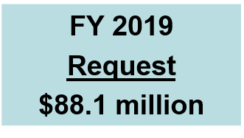
Modernizing Infrastructure for the Next 100 Years Dam Safety Program (Cont’d)
Reclamation manages 492 dams, including 363 high and significant hazard dams, and utilizes the Dam Safety Program to ensure safety and reliability
Request based on current Reclamation facility evaluation and modification needs; funding focused on priority facilities based on identified risk to the public
Provides funding for: Safety Evaluation of Existing Dams, Initiate Safety of Dams Corrective Actions, DOI Dam Safety Program
Funding requested for several dam safety modifications, including major work at Boca, Steinaker, Bull Lake, and Hyrum dams

Slide 12
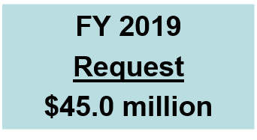
Modernizing Infrastructure for the Next 100 Years Extraordinary Maintenance (cont.)
XM budget is central to mission operating and maintaining projects to ensure delivery of water and power benefits
Funds major and non-routine maintenance, replacement and additions to existing infrastructure and structural facilities
XM budget is part of overall Asset Management Strategy and is based on assessment, condition, research and strategic collaboration
Hoover Dam
Hoover N5 Widehead Turbine Machining
Nevada, LC Region

Slide 13
Generating Revenue and Utilizing Our Natural Resources - Economy
Per the DOI Economic Report of FY 2016, Reclamation activities are estimated to contribute $48.1 billion in economic output and support approximately 388,000 jobs
Western economies are built on Reclamation water projects
Maintain and modernize infrastructure
Help develop and construct new infrastructure
Environmental Restoration supports recreation based services
As the largest wholesale supplier and manager of water in the nation, Reclamation projects and activities are foundational to economic growth
Reclamation operates 53 hydroelectric power plants that account for 15% of the hydroelectric capacity and generation in the U.S. Reclamation generates 37 billion kilowatt hours of electricity to meet the needs of over 3.5 million households, and it collects over $1.0 billion in gross power revenues.

Slide 14
Generating Revenue and Utilizing Our Natural Resources - Energy
The FY 2019 President’s Budget includes $1.1 million to support domestic energy security initiatives
Goal is to achieve operational efficiencies of hydropower facilities and promote development of new, non-federal hydropower on existing non-powered Reclamation facilities
Small Federal investment leverages large non-Reclamation investments (e.g., Bonneville Power Administration, other power customers)
Funding supports ongoing work for automated data collection, performance testing, regulatory compliance, etc.
The FY 2019 budget also requests significant funds for ongoing operation and maintenance at a number of hydroelectric power plants.
In addition to the budget request, approximately 80 percent of power generation and infrastructure costs come directly from customers and other federal agencies

Slide 15
Fulfilling our Trust: Support to Tribes
Reclamation’s efforts to support tribal nations are long standing and include implementation of water rights settlements, technical assistance, fisheries restoration, and rural water supply projects . The FY 2019 request funds a number of projects supporting tribal nations. Examples include:
$127.4 million for Indian water rights settlements including:
Navajo-Gallup Water Supply Project (NM); Crow Tribe Water Rights Settlement (MT); Aamodt Litigation Settlement (NM); Blackfeet Water Rights Settlement (MT); Nez Perce Settlement (ID) ; Ak-Chin Indian Water Rights Settlement (AZ); San Carlos Apache (AZ); and the Colorado Ute Settlement Act (CO)
$33.9 million for rural water projects that support tribal nations
$10.6 million for the Native American Affairs Program
Many other projects that include tribal benefits, such as:
Klamath Project; Trinity River Restoration Program; and the Yakima River Basin Water Enhancement Project

Slide 16
Expanding Outdoor Recreation and Access
Reclamation uses a multipurpose approach to water resource development that includes recreation, and plays a major role in providing access to recreation facilities and opportunities
Projects include approximately 6.5 million acres of land and water and over 290 recreation areas (Reclamation directly manages 42) available to the public resulting in approximately 90 million visits annually
Over 166 recreation areas are managed through public partnership arrangements to meet public needs and expectations.
Reclamation's land and water-based outdoor recreation opportunities often include camping, hiking, boating, and many other activities
Projects have created national wildlife refuges and state wildlife management areas that offer valuable fish and wildlife habitat along with hunting and fishing opportunities

Slide 17
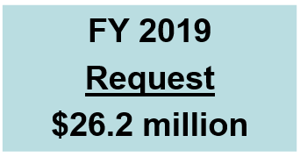
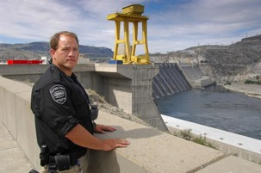
Protecting Our People and the Border Site Security
Interior places a high priority on safety, security, and preparedness in efforts to protect lives, resources, and property; Reclamation supports all such efforts and initiatives
Reclamation’s law enforcement staffing model determines the security guard capabilities and staffing levels that are needed for Reclamation’s dams, reservoirs, and power plants that constitute a portion of the nation’s critical infrastructure
Site Security funding ensures safety and security through physical security upgrades, law enforcement and risk analysis funding, and personnel security
Grand Coulee Dam, Washington, PN Region

Slide 18
Conserving Land and Water
WaterSMART supports Reclamation’s collaboration with non-Federal partners in efforts to address emerging water demands and water shortage issues in the West, to promote water conservation and improved water management, and to take actions to mitigate adverse environmental impacts of Reclamation projects
Promotes reliable solutions and economic productivity
Includes funding for cost-shared grants, basin-wide efforts to address water supply, Title XVI water recycling, collaborative watershed groups, and water conservation/drought activities

Slide 19
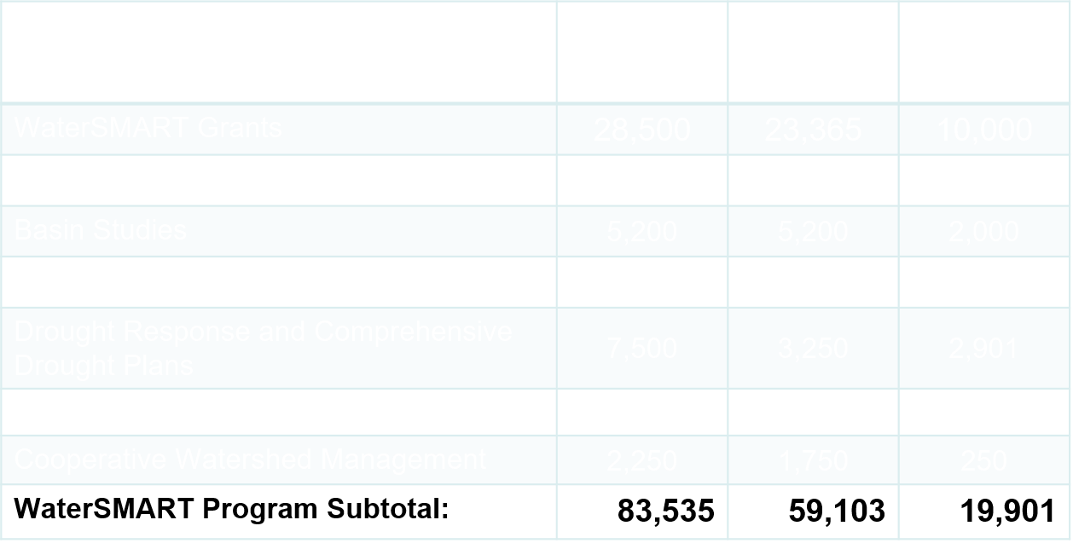
WaterSMART Program (dollars in thousands)
^{1/}FY 2017 includes additional funds provided by Congress

Slide 20
Management Efficiencies
Reclamation’s FY 2019 budget includes efforts to support and improve Federal effectiveness, efficiency, cybersecurity, and accountability through:
Title Transfer Legislative Proposal – would facilitate transfer of title when beneficial to all parties
Partner Funding – continued emphasis to seek leveraging of non-Federal and other Federal dollars
Ensure resources are located where needed to best serve public – Limited footprint in East for impact in West
Federal IT Acquisition Reform Act (FITARA) – evaluating, upgrading, and potentially replacing IT systems to manage facilities and protect infrastructure
Data Modernization – support of the open water data initiative

Slide 21
Water Reliability and Efficiency
The ability to continue to deliver water and generate power is key to Reclamation’s mission. Reclamation’s budget supports efforts to address drought, growing water demand, efficient energy production, and environmental needs well into the future. Such funding includes:
$31.2 million for the Lower Colorado River Operations Program to support the Secretary’s role as water master of the Lower Colorado River and includes $16.9 million for species conservation
$147.5 million for Central Valley Project, including $11.9 million for Trinity River Restoration
$17.5 million for studies and initiatives to improve water supply in Klamath
$23.5 million for Middle Rio Grande ($11.5 million for endangered species program)

Slide 22
Water Reliability and Efficiency (Cont.)
Funding includes:
$19.2 million for Endangered Species Act Recovery Implementation (e.g. Platte)
$19.0 million for Columbia Snake River
$13.2 million to address water shortages in the Yakima River Basin
$62.0 million for the Central Valley Project Restoration Fund (includes $1.5 million for Trinity River and $2 million for San Joaquin)
$35.0 million for the San Joaquin River Restoration program

Slide 23
Invasive Species
Reclamation is engaged in innovative research applications to detect, prevent, and mitigate impacts from invasive quagga and zebra mussels in Western U.S.
Supports framework in Quagga-Zebra Mussel Action Plan
FY 2019 includes more than $7.6 million for prevention, early detection and monitoring, containment and control at existing facilities such as Colorado River dams and pumping plants as well as outreach and education, and research.
Additional funding within programs and projects combats invasive species throughout the West

Slide 24
Colorado River
Colorado River Basin is experiencing worst drought in recorded history, and faces multiple challenges including drought, water supply/ quantity and quality, and endangered species protection
To meet these challenges, Reclamation’s FY 2019 budget.
Continues development of Drought Contingency Plans, including conservation of water in Lake Mead to avoid shortage conditions
Continues implementation/monitoring of Minute 323 to the US-Mexico 1944 Treaty for operational certainty, water conservation and exchange, and enhancement of environmental and riparian resources until 2026
Continues Title I and Title II Salinity Control efforts
Continues implementation of the Long-Term Experimental and Management Plan (LTEMP) Record of Decision regarding adaptively managing Glen Canyon Dam operations including conservation measures and environmental compliance performance measures

Slide 25
California Water
California Bay-Delta Restoration - $35.0 Million
Includes $35.0 million for the continuation of the CALFED Bay-Delta Program consistent with the Record of Decision (ROD) and current priorities
Focuses on interagency science efforts to address short- & long-term resource and water reliability issues
California Bay-Delta Restoration was authorized by the 2008 Water Supply Reliability, and Environmental Improvement Act, P.L. 108-361. Authorization was extended through September 30, 2019 in the 2016 WIIN Act
San Joaquin River Restoration - $35.0 Million
Program established by the 2009 San Joaquin River Restoration Settlement Act, Title X, Subtitle A of P.L. 111-11
In October 2006, a Federal court approved a settlement on the San Joaquin River by Interior, Department of Commerce, Natural Resources Defense Council, and Friant Water Users Authority, ending 18 years of litigation
FY 2019 funding will continue activities for settlement implementation with a focus on continued construction of the Mendota Pool Bypass

Slide 26
California Water (cont.)
Central Valley Project Restoration Fund (CVPRF) - $62.0 Million
Fund was established by the1992 Central Valley Project Improvement Act (CVPIA), Title XXXIV of P.L. 102-575
CVPRF funding assists in the protection, restoration and enhancement of fish and wildlife, and associated habitats in the Central Valley Project area of California
The request for CVPRF is higher in FY 2019 based on a three-year rolling average of collections

Slide 27
Research and Development
The Research and Development Office administers the Science and Technology (S&T) Program and the Desalination and Water Purification Research Program (DWPR)
S&T develops impactful and innovative solutions to technical problems confronting Reclamation
The FY 2019 request includes $11.0 million to support research projects, technology prize competitions, technology transfer, and dissemination of results
These program elements result in increased water deliveries, reduced water losses, improved water and power infrastructure management, more efficient hydropower generation, and more effectively meeting our environmental responsibilities
The DWPR program supports development of innovative and more cost-effective methods of desalination in order to develop new water supplies
The FY 2019 request at $2.9 million supports new and continued projects in the two funding areas: laboratory scale research studies and pilot-scale testing projects
Funding also supports the O&M of Reclamation’s Brackish Groundwater National Desalination Research Facility (BGNDRF), which will continue to support research- to pilot-scale testing projects, as well as engage private-sector and other non-Federal interests via technology transfer activities

Slide 28
FY 2018 Additional Funding (dollars in thousands)
If additional funds are received in an FY 2018 appropriations bill, allocation will be based on a thorough review Reclamation-wide to ensure a balanced approach that considers projects and programs on the basis of mission priorities, program objectives, and the directions that may be contained in the Joint Explanatory Statement from Congress

Slide 29
https://www.usbr.gov/budget

